Slide 1
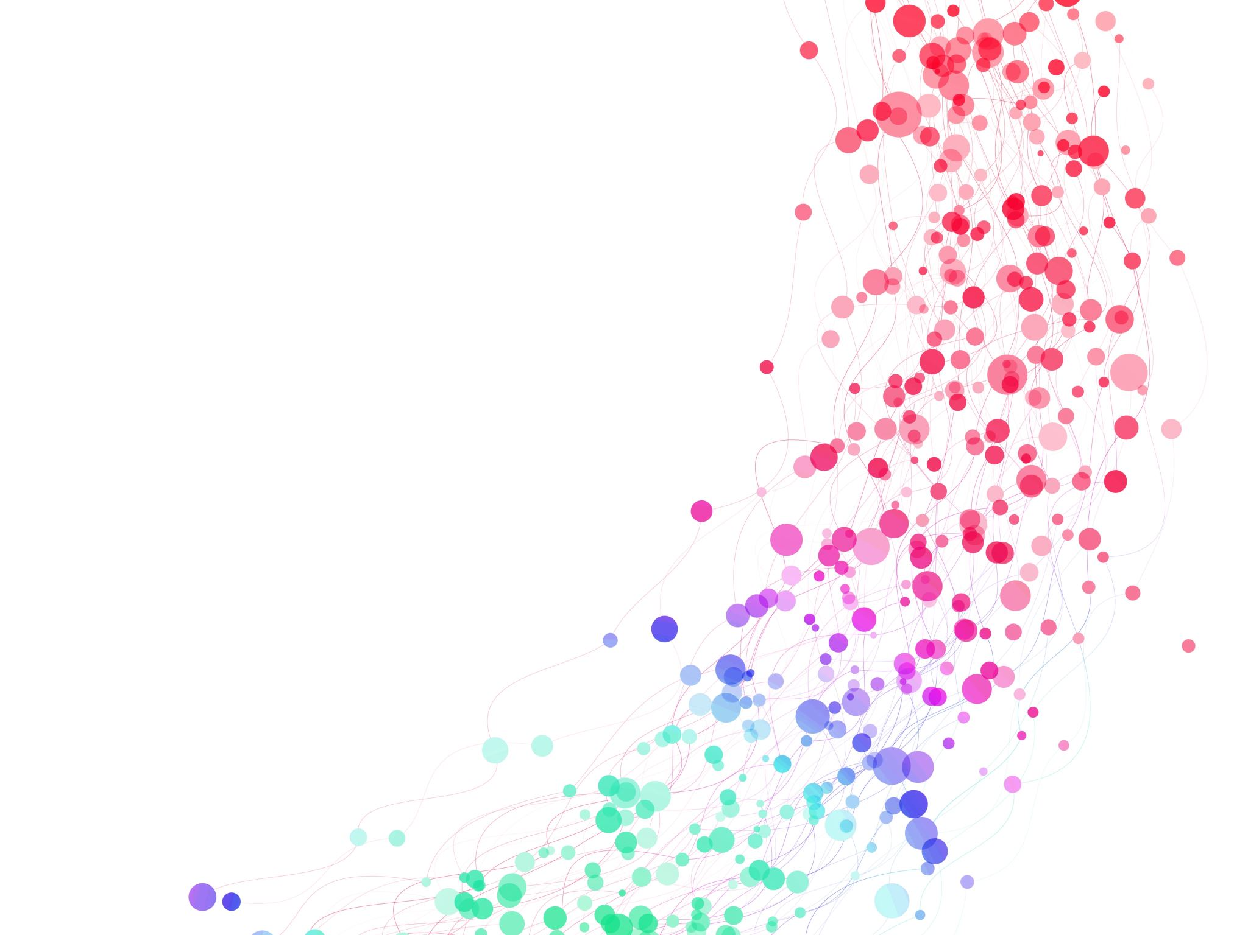

Concept-based Interpretable Deep Learning
AAAI 2025 – Philadelphia, USA

Slide 2




Who are we?
Mateo Espinosa Zarlenga
Final-year PhD Student
University of Cambridge
me466@cam.ac.uk
Pietro Barbiero
Swiss Postdoctoral Fellow
IBM Research (Switzerland)
pietro.barbiero@ibm.com

Slide 3
What is this tutorial about?
Deep Learning
CL
Human-AI Interaction
Representation Learning
We will look at how Concept Learning (CL) can be used to design interpretable Deep Neural Networks

Slide 4
Tutorial goals
Our main goals for this tutorial are threefold:
Provide a non-exhaustive but well-rounded overview of concept learning (CL).
Convince you that concept representations can be very useful for designing powerful but interpretable neural models.
Bring together a variety of resources (surveys, method papers, libraries, etc.) to facilitate access to the current state of CL.

Slide 5
What is this tutorial not about?

Slide 6
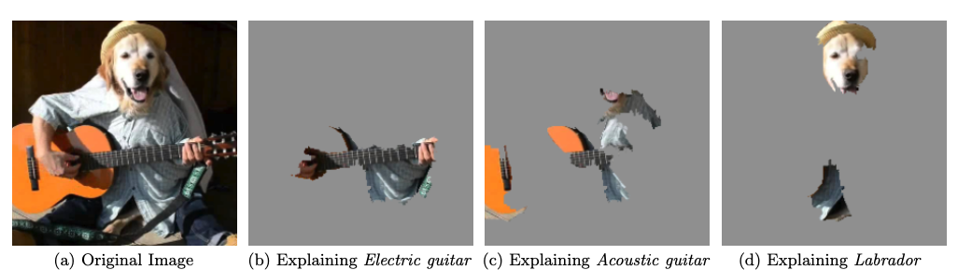
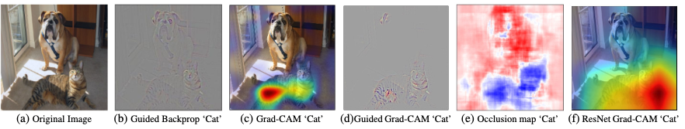
What is this tutorial not about?
We will not have time to dive deep into:
“Traditional” explainable AI (XAI) methodologies
Example of LIME (taken from [1])
Example of GradCAM and other saliency methods (taken from [2])
[1] Ribeiro et al. ”’Why should i trust you?’ Explaining the predictions of any classifier." KDD (2016).
[2] Selvaraju, et al. "Grad-cam: Visual explanations from deep networks via gradient-based localization." ICCV (2017).

Slide 7
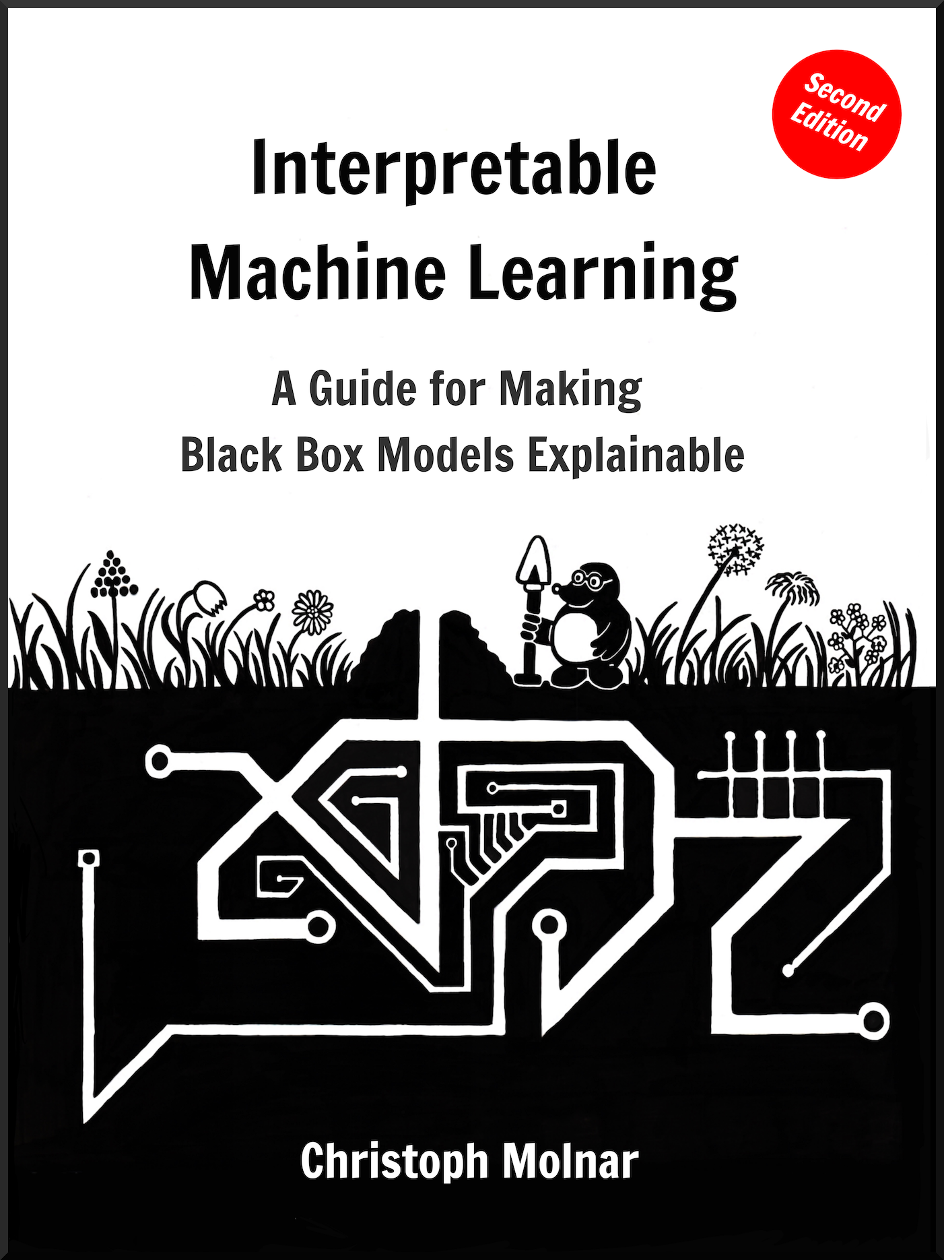

What is this tutorial not about?
We will not have time to dive deep into:
“Traditional” explainable AI (XAI) methodologies
Link to Book
Interpretable Machine Learning
Christoph Molnar
[1] Molnar, Christoph. Interpretable machine learning. Lulu. com, 2020.

Slide 8
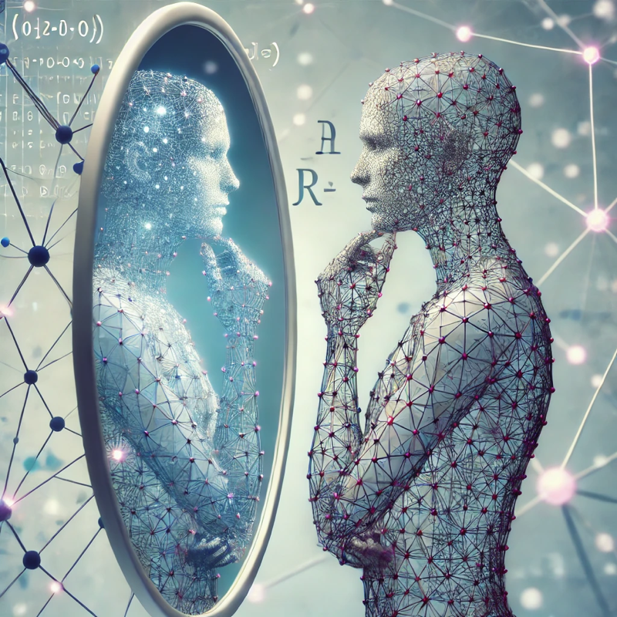



What is this tutorial not about?
We will not have time to dive deep into:
“Traditional” explainable AI (XAI) methodologies
Deep philosophical aspects of explaining models
The Mythos of Interpretability
Lipton et al. (2018) [1]
To Explain or to Predict?
Galit (2018) [2]
Explanation Theory
Bromberger (1992) [3]
[1] Lipton, Zachary C. "The mythos of model interpretability: In machine learning, the concept of interpretability is both important and slippery." Queue (2018).
[2] Galit Shmueli. "To Explain or to Predict?." Statist. Sci. 25 (3) 289 - 310, August 2010. https://doi.org/10.1214/10-STS330
[3] Bromberger, Sylvain. On what we know we don't know: Explanation, theory, linguistics, and how questions shape them. University of Chicago Press, 1992.
Notes:
Lipton, Zachary C. "The mythos of model interpretability: In machine learning, the concept of interpretability is both important and slippery." Queue 16.3 (2018): 31-57.

Slide 9
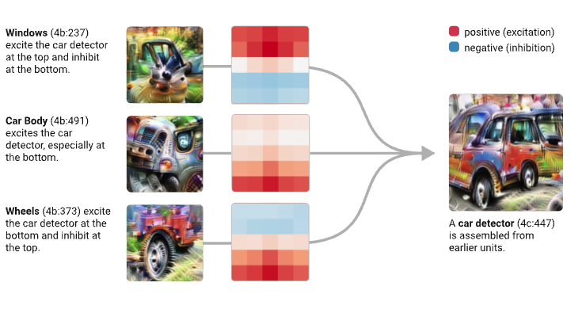

What is this tutorial not about?
We will not have time to dive deep into:
“Traditional” explainable AI (XAI) methodologies
Deep philosophical aspects of explaining models
Connections with Mechanistic Interpretability
Circuits
Taken from [1]
[1] Olah, Chris, et al. "Zoom in: An introduction to circuits." Distill 5.3 (2020): e00024-001.

Slide 10


What is this tutorial not about?
We will not have time to dive deep into:
“Traditional” explainable AI (XAI) methodologies
Deep philosophical aspects of explaining models
Connections with Mechanistic Interpretability
Distill Circuits Thread
Anthropic Circuits Thread
[1] Cammarata, Nick, et al. "Thread: circuits." Distill 5.3 (2020): e24.
[2] Anthropic “Transformer Circuits Thread” found at https://transformer-circuits.pub/

Slide 11
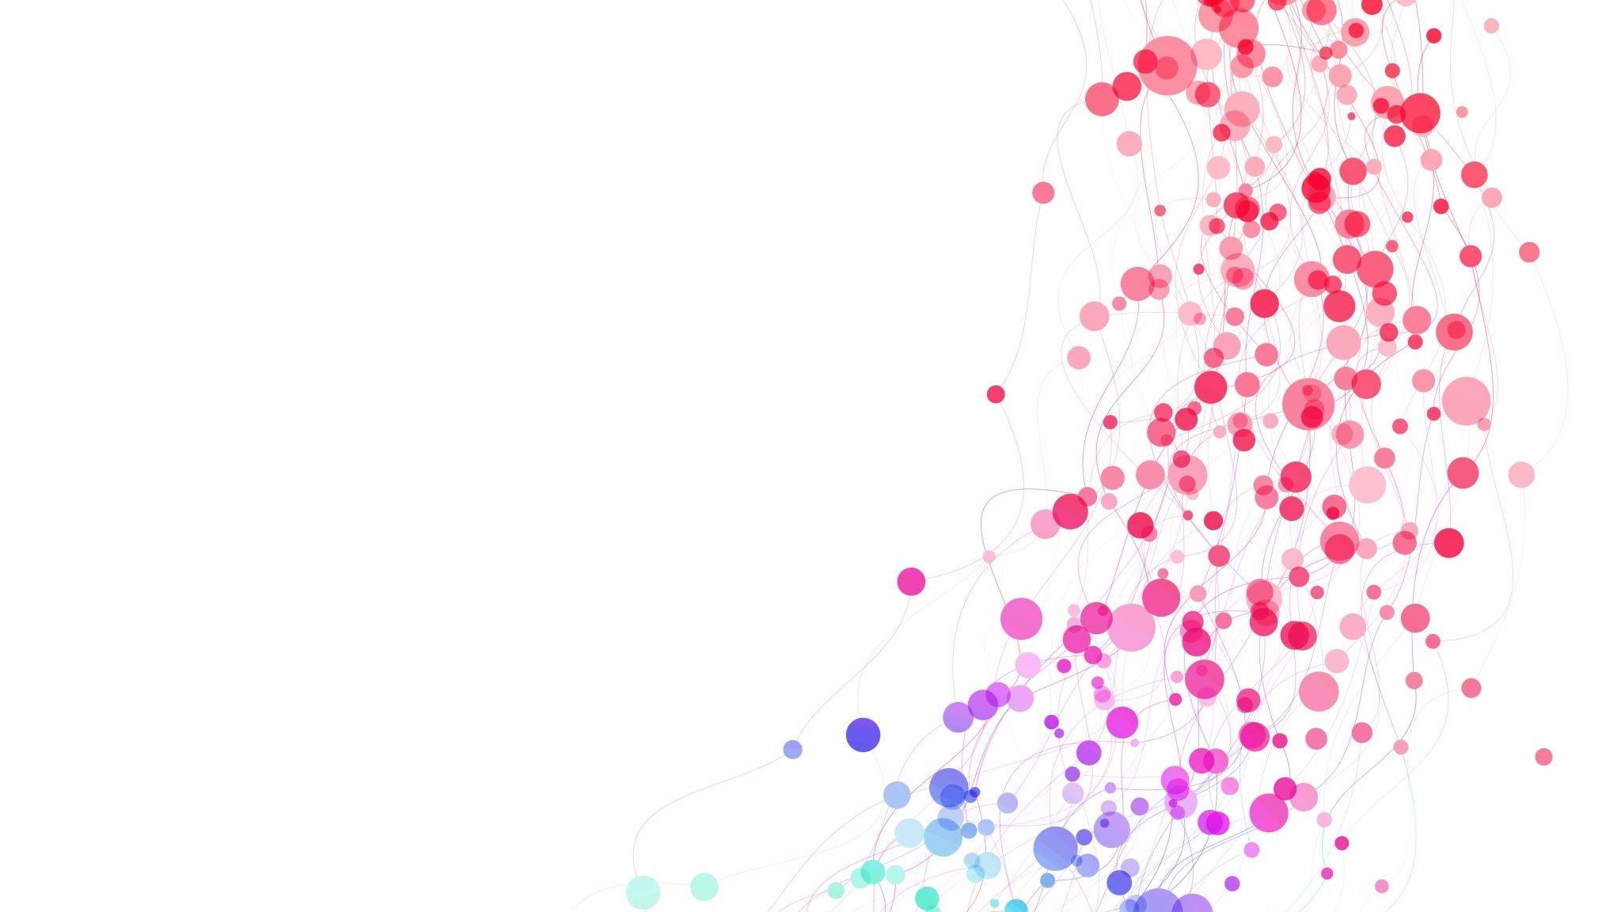
Tutorial outline
Introduction
Supervised Concept Learning
Concept Interventions
Q&A + Break
Unsupervised Concept Learning
Reasoning With Concepts
Future Directions
Q&A

Slide 12
Tutorial outline
14:00 – 15:35
Introduction
Supervised Concept Learning
Concept Interventions
Q&A + Break
Unsupervised Concept Learning
Reasoning With Concepts
Future Directions
Q&A
Mateo

Slide 13
Tutorial outline
Introduction
Supervised Concept Learning
Concept Interventions
Q&A + Break
Unsupervised Concept Learning
Reasoning With Concepts
Future Directions
Q&A
15:35 – 16:15
(10 mins + 30 mins)

Slide 14
Tutorial outline
Introduction
Supervised Concept Learning
Concept Interventions
Q&A + Break
Unsupervised Concept Learning
Reasoning With Concepts
Future Directions
Q&A
16:15 – 17:50
Pietro

Slide 15
Tutorial outline
Introduction
Supervised Concept Learning
Concept Interventions
Q&A + Break
Unsupervised Concept Learning
Reasoning With Concepts
Future Directions
Q&A
17:50 – 18:00
(10 mins)

Slide 16

Tutorial Website and materials
This tutorial’s slides, schedule, and resources are in our website:
https://conceptlearning.github.io/

Slide 17
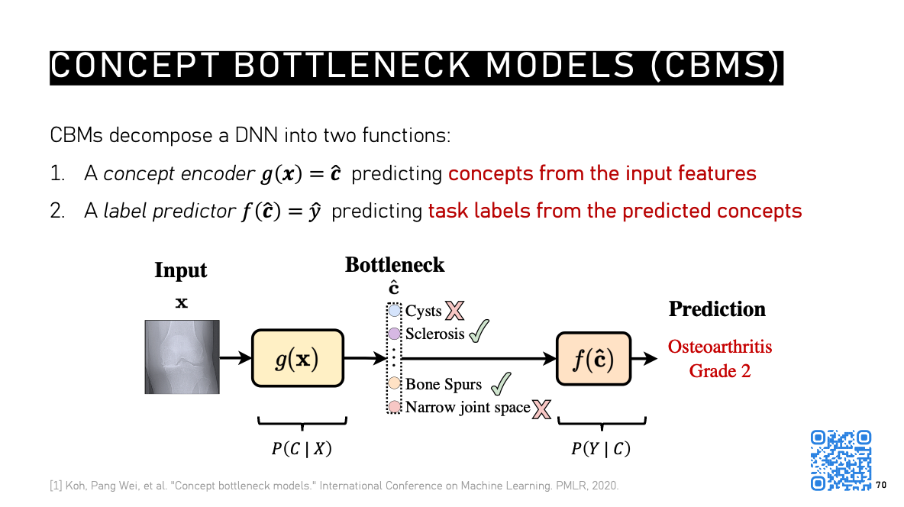
Tutorial Website and materials
Throughout the tutorial, watch for QR codes to relevant references
Citation + Hyperlink
(if you download slides)
QR code to paper/reference/extra material

Slide 18
Tutorial outline
Introduction
Supervised Concept Learning
Concept Interventions
Q&A + Break
Unsupervised Concept Learning
Reasoning With Concepts
Future Directions
Q&A

Slide 19








A Swiss army knife for Ai
Artificial Intelligence (AI) has experienced a boom in the last decade driven by so-called Deep Neural Networks (DNNs)
$$g_{1}\left(x\right)$$
$$x$$
$$h_{0}$$
$$g_{2}\left(h_{1}\right)$$
$$\hat{y}$$
$$W_{1}$$
$$W_{2}$$
$$g_{i+1}\left(h_{i}\right)=σ\left(W_{i+1}h_{i}+b_{i+1}\right)$$
Goal: learn $\left\{W_{1}, b_{1}, ⋯W_{m}, b_{m}\right\}$ s.t. $\left(g_{m}∘⋯∘g_{2}∘g_{1}\right)\left(x\right)= \hat{y}≈y$
[1] Image adapted from Deep Learning Courses at “https://deeplearningcourses.com/c/deep-reinforcement-learning-in-python”

Slide 20

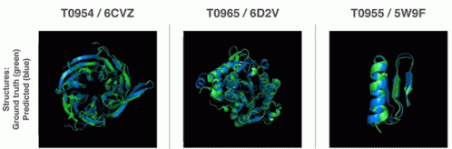

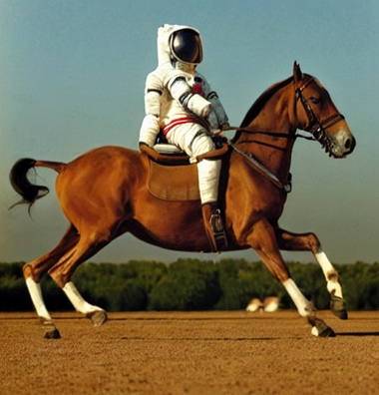
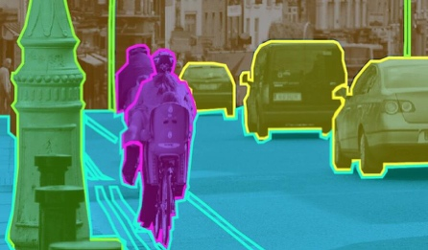
The power of scale
Scaling up DNNs can lead to expressive and generalisable models:
+
A LOT of data, money, time, and sweat
=
[1] Silver, David, et al. "Mastering the game of Go with deep neural networks and tree search." nature 529.7587 (2016): 484-489.
[2] OpenAI. "GPT-4 technical report." arXiv (2023).
[3] Jumper, John, et al. "Highly accurate protein structure prediction with AlphaFold." nature 596.7873 (2021): 583-589.
[4] Rombach, Robin, et al. "High-resolution image synthesis with latent diffusion models." CVPR (2022).

Slide 21
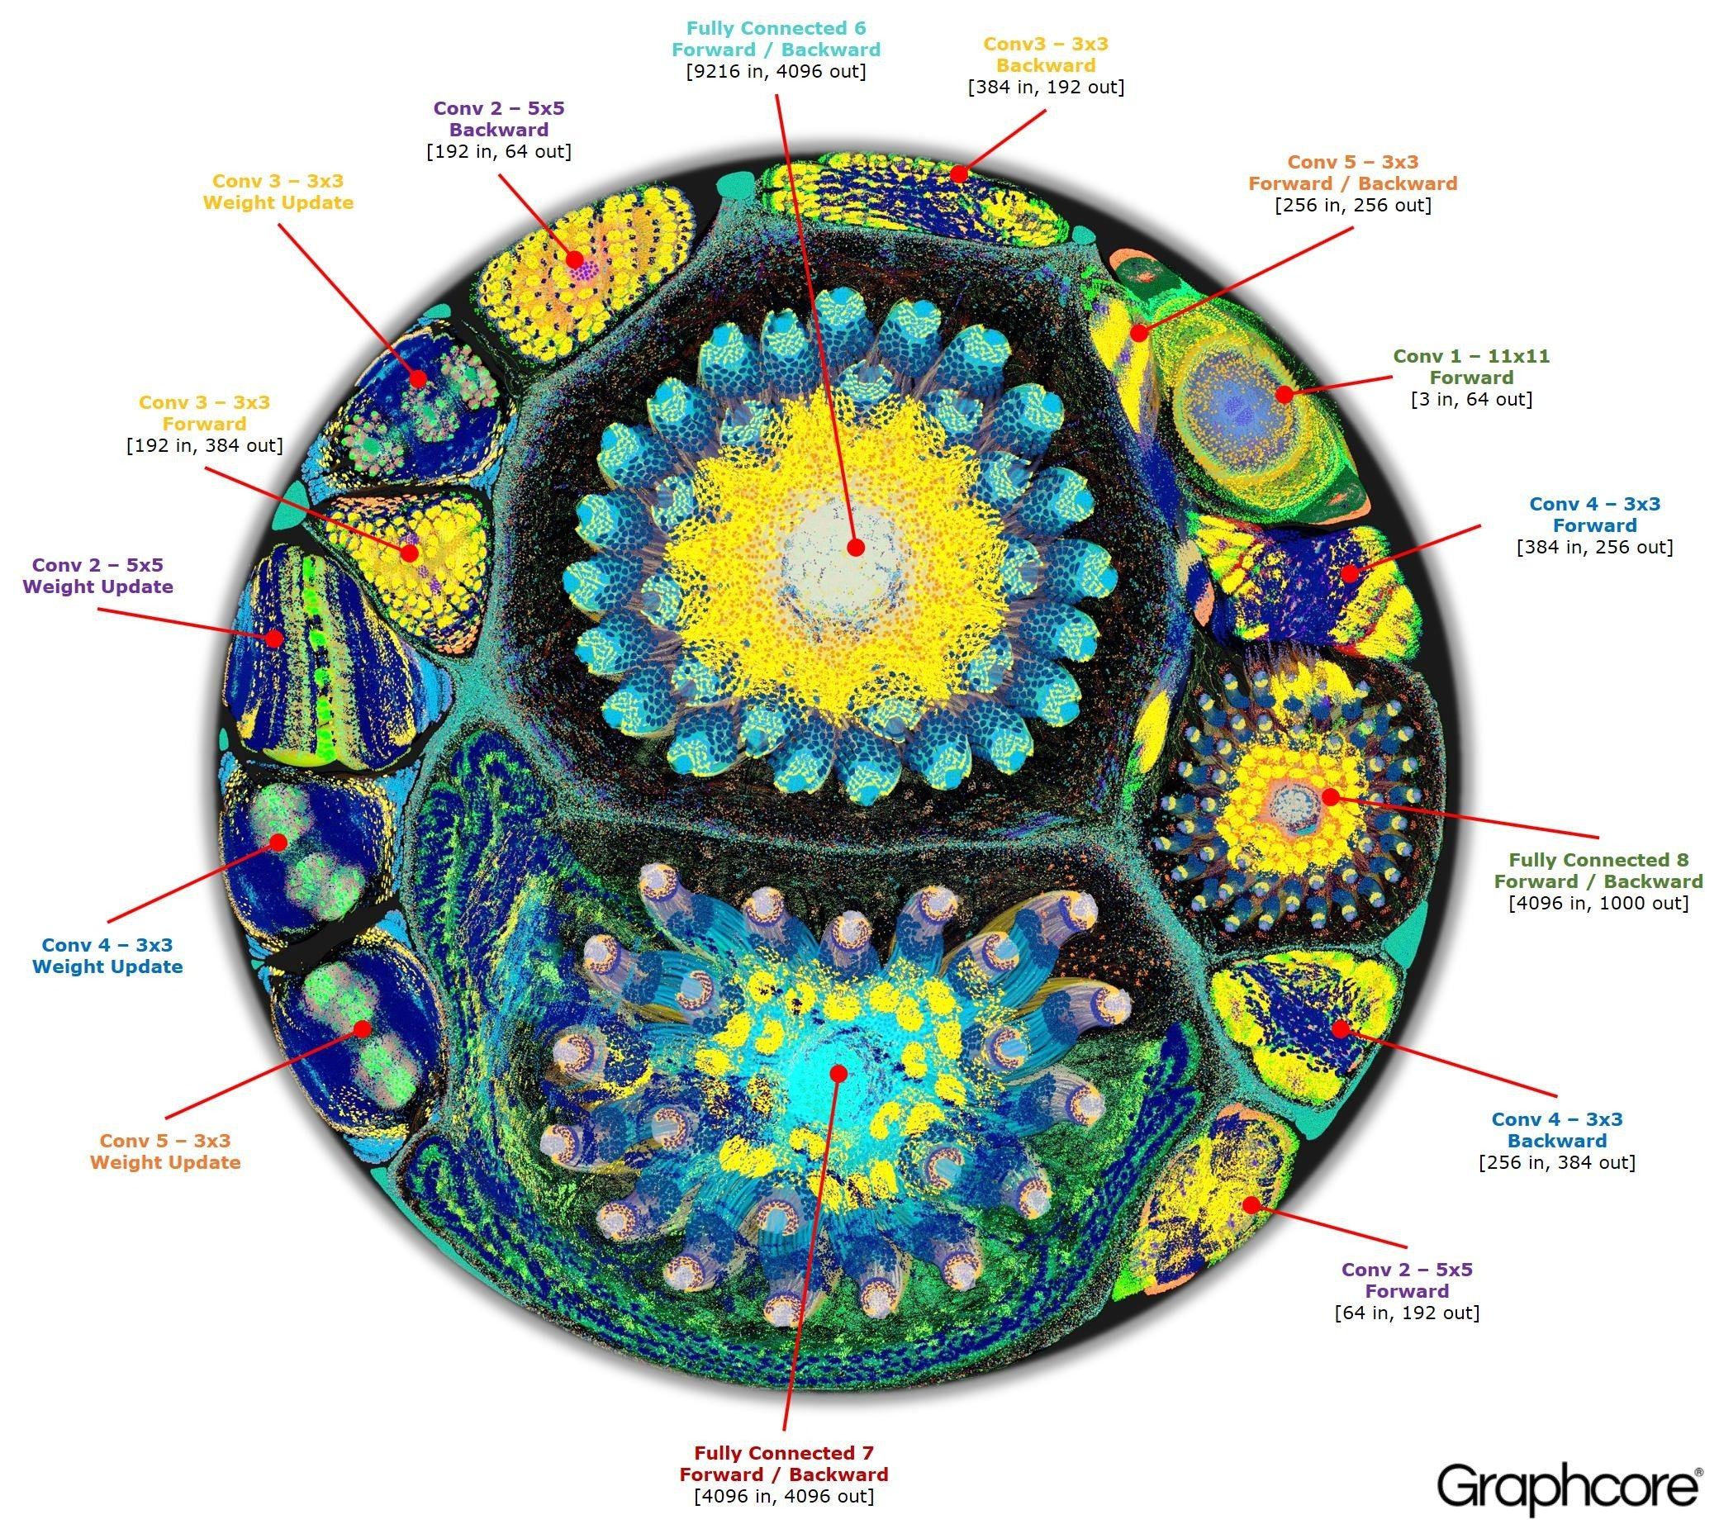
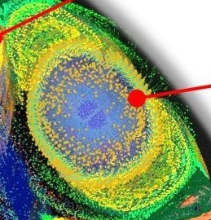
The black-box problem
Scale, however, leads to notoriously complex models!
[1] Adapted from Graphcore, “Inside an AI ‘Brain’ – What does Machine Learning Look Like?” (2017)
Notes:
This is an AlexNet model (~60M parameters)

Slide 22

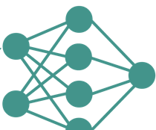


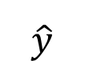
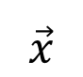
The black-box problem
Scale, however, leads to notoriously complex models!
Black box Functions
Deep Neural Networks
Highly parametric
Complex forward passes
Continuous activations
Sensitive to initial states and update rules
$$≈$$
$$\vec{x}$$
$$\hat{y}$$
DNNs are ”black-box” models

Slide 23
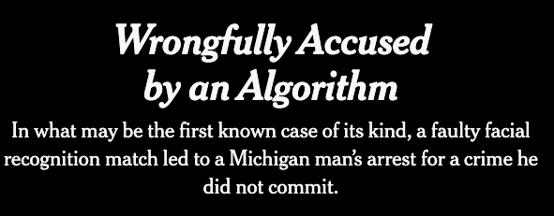
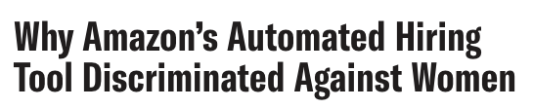
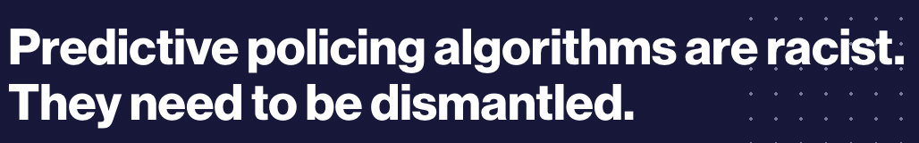
The flip side of the coin
Blindly using black-box models can lead to all sorts of problems:
[1] Kashmir Hill, “Wrongfully Accused by an Algorithm.” The New York Times (2020).
[2] Rachel Goodman, “Why Amazon’s Automated Hiring Tool Discriminated Against Women.” ACLU (2018).
[3] Will Douglas Heaven, “Predictive policing algorithms are racist. They need to be dismantled.” MIT Technology Review (2020).

Slide 24
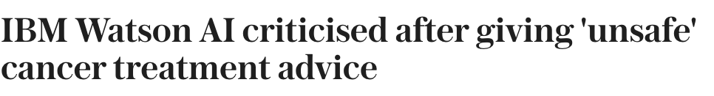
The flip side of the coin
Blindly using black-box models can lead to all sorts of problems:
It’s not all bad news ☺
[1] Natasha Bernal, “IBM Watson AI criticised after giving 'unsafe' cancer treatment advice.” The Telegraph (2018).
[2] Kashmir Hill, “Wrongfully Accused by an Algorithm.” The New York Times (2020).
[3] Rachel Goodman, “Why Amazon’s Automated Hiring Tool Discriminated Against Women.” ACLU (2018).
[4] Will Douglas Heaven, “Predictive policing algorithms are racist. They need to be dismantled.” MIT Technology Review (2020).

Slide 25
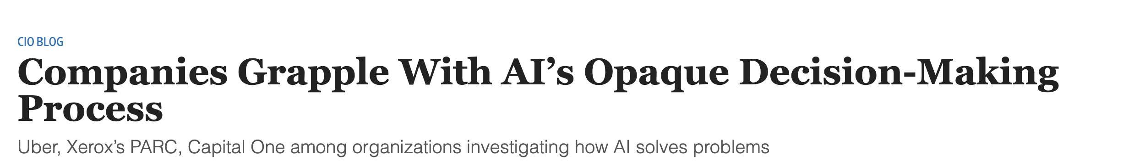
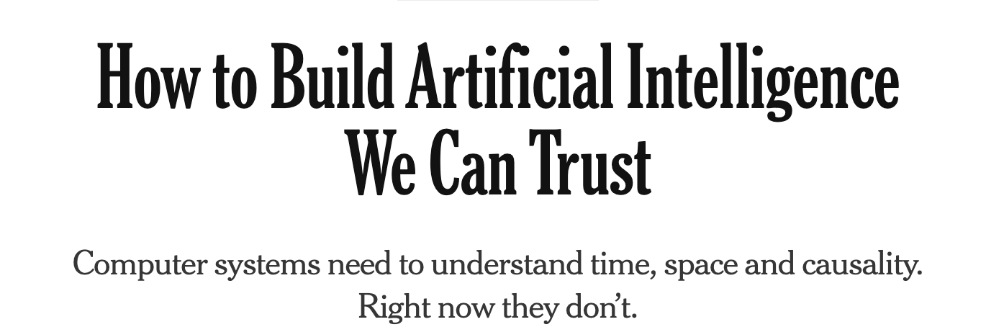
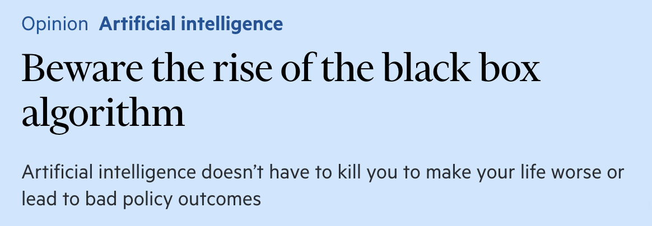
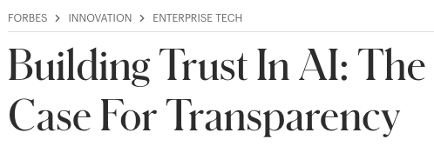


Explaining DNNs
Recent advances in AI came with a rise in interest in making these models “interpretable”

Slide 26
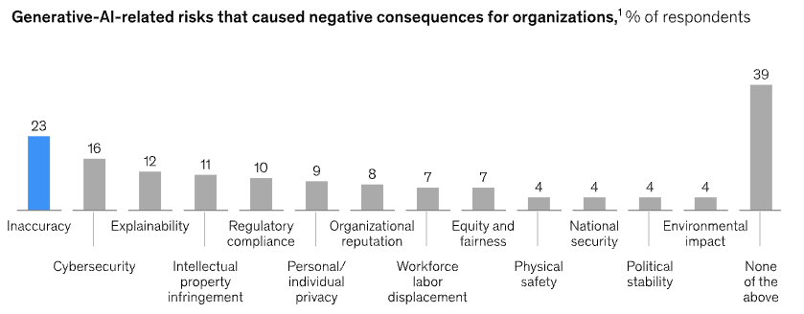

Explaining DNNs
Recent advances in AI came with a rise in interest in making these models “interpretable”
The State of AI in 2024 (McKinsey)
[1] McKinsey “The state of AI in early 2024: Gen AI adoption spikes and starts to generate value” (2024)

Slide 27


Explaining DNNs
This interest has manifested itself at the regulatory/legal level
General Data Protection Regulations (GDPR, 2016):
“The data subject shall have the right not to be subject to a decision based solely on automated processing, including profiling,…” (Art. 22)
The data subject has the right to “meaningful information about the logic involved” in the decision. (Art. 13 and 15)
EU AI Act (2024):
“Any affected person subject to a decision which is taken by.. a high-risk AI system … shall have the right to obtain from the deployer clear and meaningful explanations (Art. 86)
GDRP
EU AI Act
[1] GDPR, EU. "Automated individual decision-making, including profiling." (2022).
[2] Act, EU Artificial Intelligence. "The EU Artificial Intelligence Act." (2024).

Slide 28
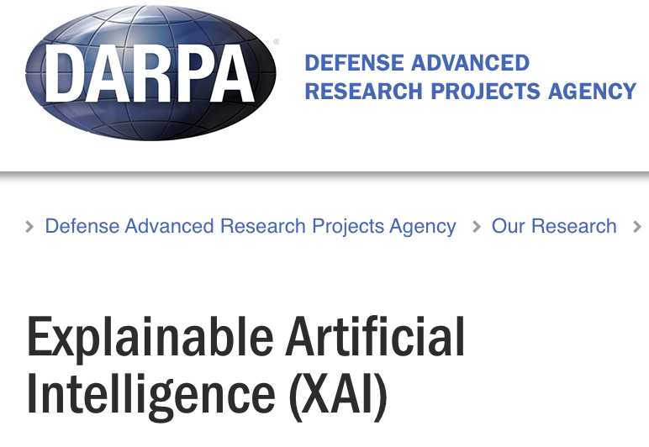

Explaining DNNs
Researchers in Explainable Artificial Intelligence (XAI*) have developed a significant number of methods to explain DNNs
(DARPA 2016)
(EU Horizon Program)
*Not to be confused with a certain bird-related company

Slide 29








First things first: terminology
Welcome to the Wild West of XAI terminology
Goebel et al. (2018)
Freiesleben et al. (2023)
Explainability
Interpretability
Transparency
Vilone et al. (2021)
Gilpin et al. (2018)
Confalonieri et al. (2020)
Rudin et al. (2019)
Understandability
Barredo Arrieta et al. (2020)

Slide 30
First things first: terminology
Here we will use some the following definitions by Gilpin et al. [1]:
Explainability (why): the ability to answer questions of the form “why does this particular input lead to that particular output?”
Interpretability (how): the ability to describe “the internals of a system in a way that is understandable to humans.”
[1] Gilpin et al. "Explaining explanations: An overview of interpretability of machine learning." DSAA (2018).

Slide 31
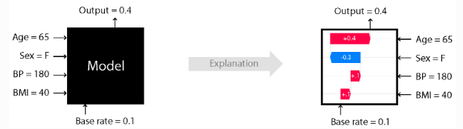

Feature attribution
XAI methods have traditionally explained a model’s prediction by estimating how important each input feature is for the output
We call these feature importance or feature attribution methods
SHAP (Scott et al., 2017)
[1] Scott, M., and Lee Su-In. "A unified approach to interpreting model predictions." NeurIPS (2017).

Slide 32
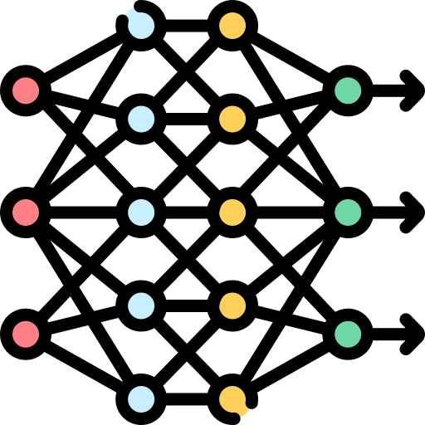
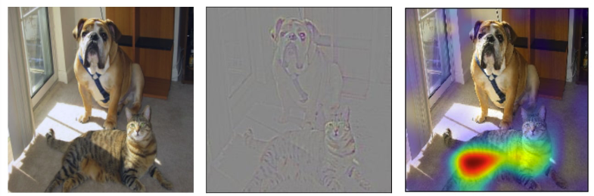


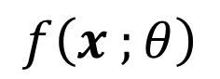


Saliency: feature attribution in dnns
DNN-specific attribution methods are called saliency methods
$$ψ\left( , , \text{cat}\right)=$$
$$\hat{y}$$
$$x$$
$$f\left(x ;θ\right)$$
These are usually computed by measuring model sensitivity via its gradient $\frac{∂f{\left(x\right)}_{y}}{∂x_{i}}$
[1] Example taken from Selvaraju et al. "Grad-cam: Visual explanations from deep networks via gradient-based localization." ICCV (2017).

Slide 33
What’s wrong with feature ATTRIBUTION?

Slide 34
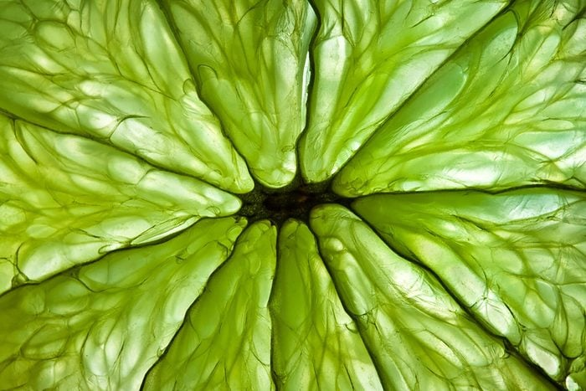
What’s wrong with feature ATTRIBUTION?
1. Low-level features like individual pixels are not always semantically meaningful:
Can you guess what this is?
[1] Andrey Armyagov/Shutterstock

Slide 35

What’s wrong with feature ATTRIBUTION?
1. Low-level features like individual pixels are not always semantically meaningful:
Limes!
[1] ZaZa Studio/Shutterstock

Slide 36
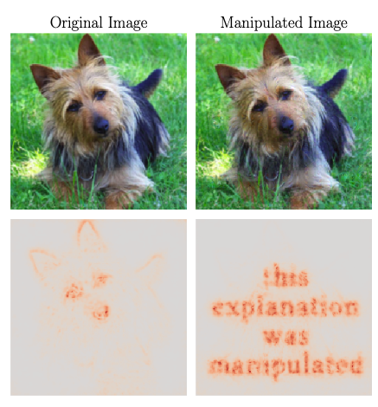
What’s wrong with feature ATTRIBUTION?
2. Saliency maps lack of actionability!
What does this really tell you about how the model made a prediction?
[1]Image adapted from Dombrowski et al. "Explanations can be manipulated and geometry is to blame." NeurIPS (2019).

Slide 37
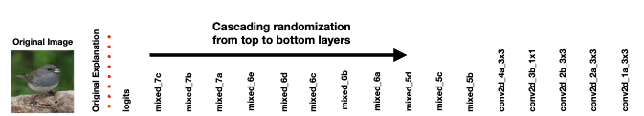
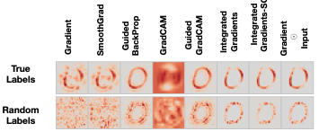
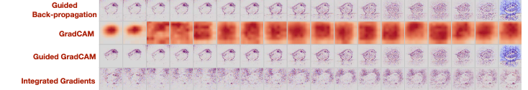

What’s wrong with feature ATTRIBUTION?
3. Several saliency methods fail very simple sanity checks
Random training labels do not always lead to random maps [1]
Random weights do not always lead to random maps [1]
[1] Adebayo, Julius, et al. "Sanity checks for saliency maps." NeurIPS (2018).

Slide 38

What’s wrong with feature ATTRIBUTION?
4. Saliency methods are susceptible to adversarial attacks [1,2]
[1] Dombrowski et al. "Explanations can be manipulated and geometry is to blame." NeurIPS (2019).
[2] Also relevant Ghorbani et al. "Interpretation of neural networks is fragile." AAAI (2019).

Slide 39
What’s wrong with feature ATTRIBUTION?
How can we go around the limitations of feature attribution?
Here, we will focus on using so-called “concepts” to construct explanations

Slide 40
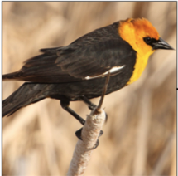
What are concepts?
Concepts are high-level and semantically meaningful units of information
Concepts are terms or units of information used by domain experts to communicate or explain things to each another
Task: bird species
Explanation of the prediction:
wing color
beak length
tail shape

Slide 41
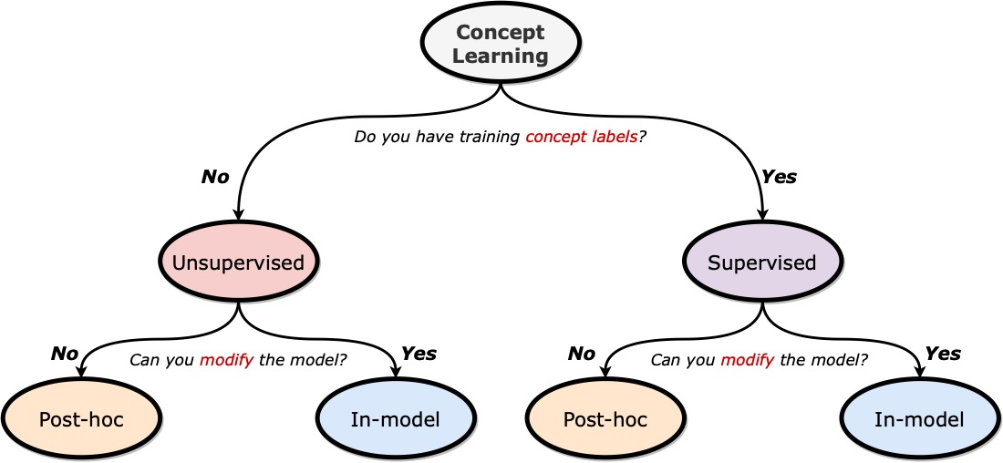

A map of concept learning
[1] For a more complete taxonomy, see Poeta et al. "Concept-based explainable artificial intelligence: A survey." arXiv (2023).

Slide 42
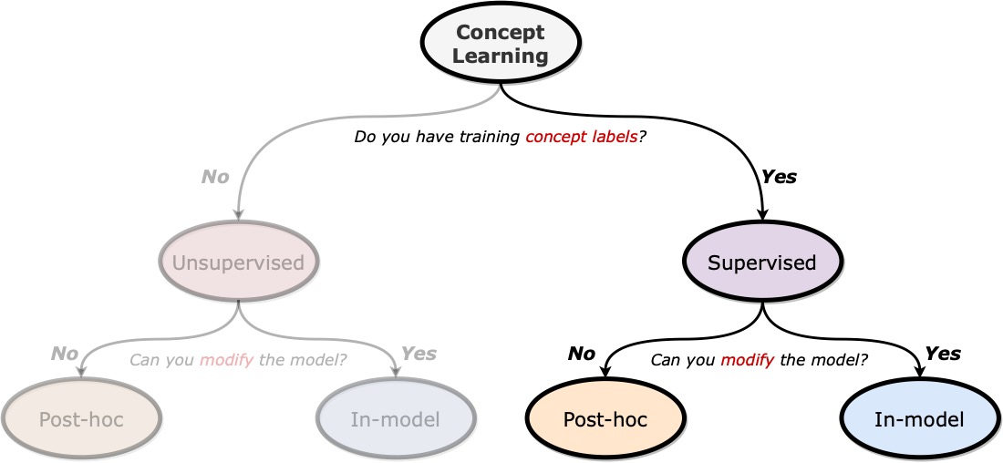
A map of concept learning
1/3
In the first third of this tutorial, we will discuss supervised concept learning

Slide 43
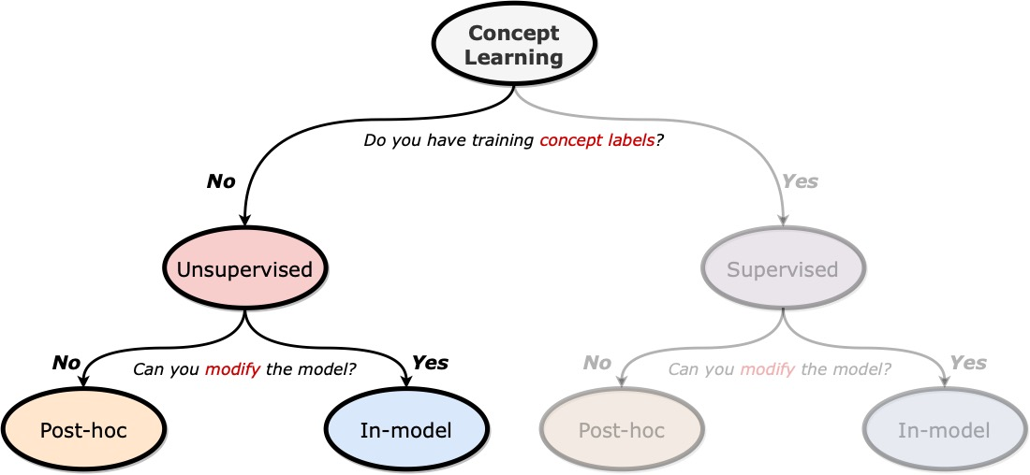
A map of concept learning
2/3
The second third discusses unsupervised concept learning approaches

Slide 44
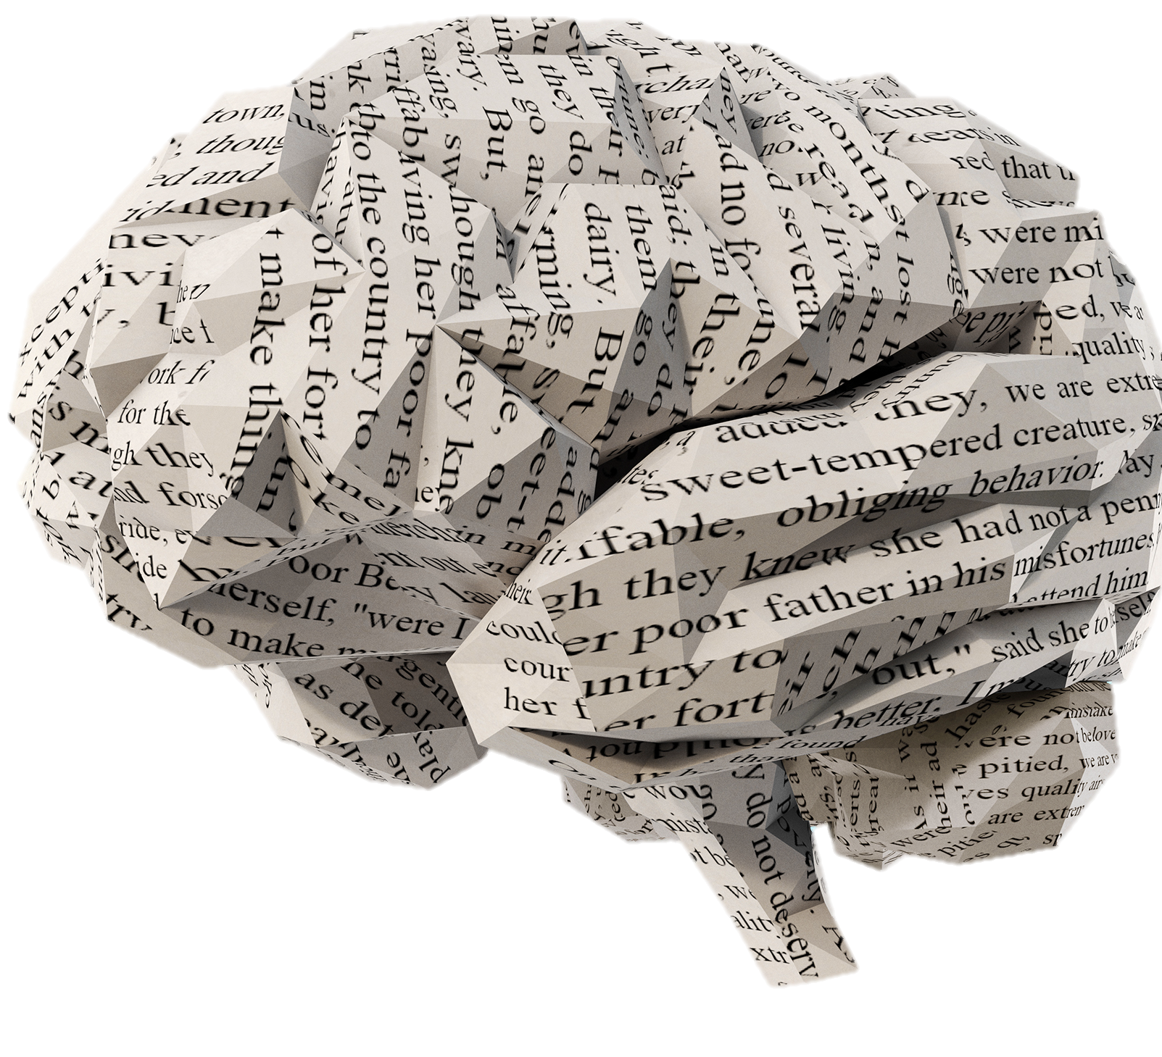
A map of concept learning
+
Reasoning
Concepts
3/3
Finally, in the last third we discuss applications of CL to symbolic reasoning

Slide 45
Tutorial outline
Introduction
Supervised Concept Learning
Concept Interventions
Q&A + Break
Unsupervised Concept Learning
Reasoning With Concepts
Future Directions
Q&A

Slide 46





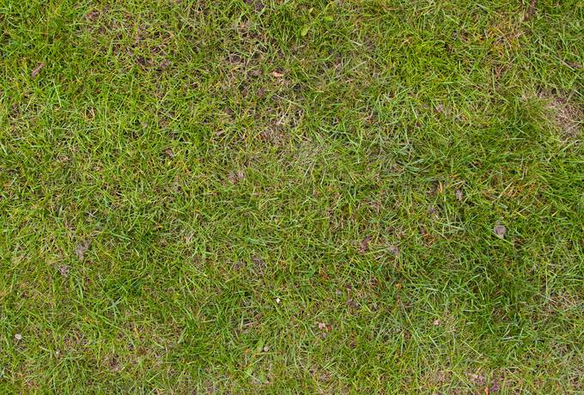










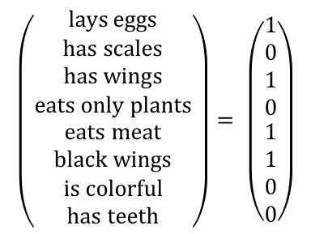
Different Levels of supervision
”Supervised” is a loaded term. In this tutorial’s context, ”supervised” means a method has access to “concept” labels
These labels could come besides other downstream task “labels”
$$X_{stripes}$$
$$x^{\left(i\right)}$$
$$c^{\left(i\right)}$$
$$X_{grass}$$
$$\left({\begin{aligned}\text{lays} \text{eggs} \\ \text{has} \text{scales} \\ \text{has} \text{wings} \\ \text{eats} \text{only} \text{plants}\end{aligned} \atop \begin{aligned}\text{eats} \text{meat} \\ \text{black} \text{wings} \\ \text{is} \text{colorful} \\ \text{has} \text{teeth}\end{aligned}}\right)= \left({\begin{aligned}1 \\ 0 \\ 1 \\ 0\end{aligned} \atop \begin{aligned}1 \\ 1 \\ 0 \\ 0\end{aligned}}\right)$$
OR
Sparse sets of images containing a concept
Dense binary vector annotations

Slide 47

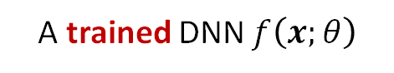
Post-hoc Concept Learning
We will start by looking into supervised post-hoc concept learning:
A trained DNN $f\left(x;θ\right)$
Sparse concept annotations
Concept-based Explanations
$$X_{stripes}$$
Local
How important is “stripes” for a prediction?
$$X_{grass}$$
Global
how important is “grass” for the class “cow”?
Given
We Want

Slide 48
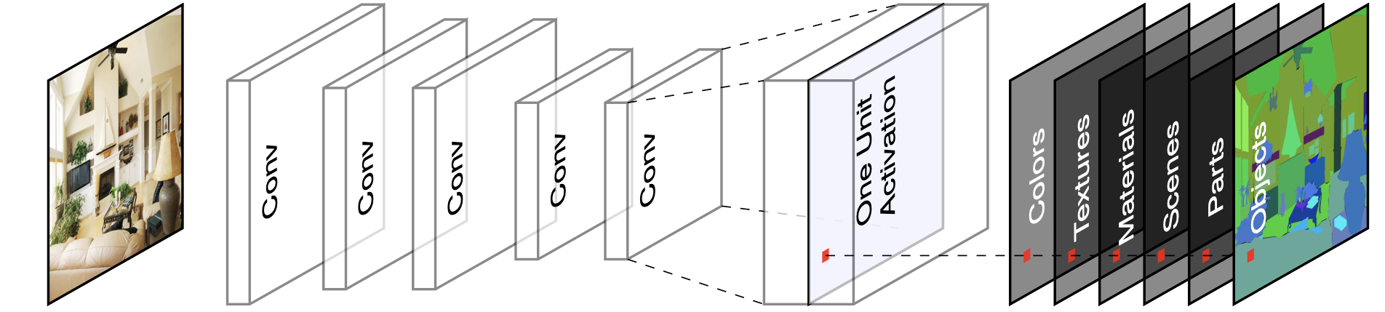

Why should we even attempt this?
Evidence suggests DNNs may predict based on concepts
[1] Bau, David, et al. "Network dissection: Quantifying interpretability of deep visual representations." CVPR (2017).

Slide 49
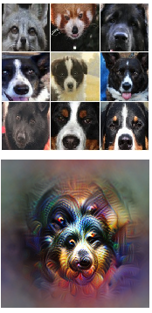
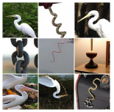

Why should we even attempt this?
Evidence suggests DNNs may predict based on concepts
“Snout” Neuron?
Activating Samples
“Curvy” Neuron?
[1] Examples taken from Olah et al. "Feature visualization." Distill 2.11 (2017).

Slide 50

Why should we even attempt this?
Evidence suggests DNNs may predict based on concepts
“Snout” Neuron?
Activating Samples
Neuron Maximisation
“Curvy” Neuron?
[1] Examples taken from Olah et al. "Feature visualization." Distill 2.11 (2017).

Slide 51
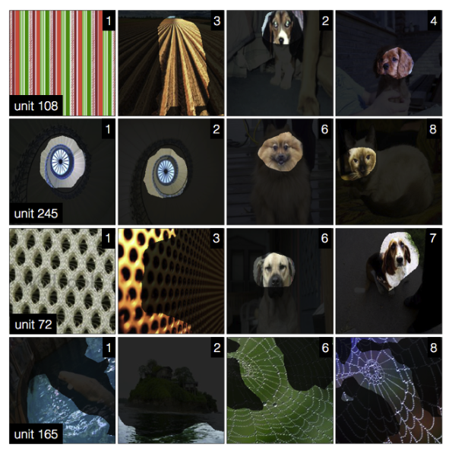

Concepts are not always localised
Concepts may not be always localised to specific neurons/maps but they may be distributed across the DNN’s latent space
The same units appear to represent different concepts
This is sometimes called Polysemanticity (Olah et al., 2020)
[1] Fong et al. "Net2vec: Quantifying and explaining how concepts are encoded by filters in deep neural networks.” CVPR (2018).

Slide 52
Concepts are not always localised
Concepts may not be always localised to specific neurons/maps but they may be distributed across the DNN’s latent space
Could we then try and capture directions in the latent space that are associated with known concepts?
The same units appear to represent different concepts
This is sometimes called Polysemanticity (Olah et al., 2020)
[1] Fong et al. "Net2vec: Quantifying and explaining how concepts are encoded by filters in deep neural networks.” CVPR (2018).

Slide 53
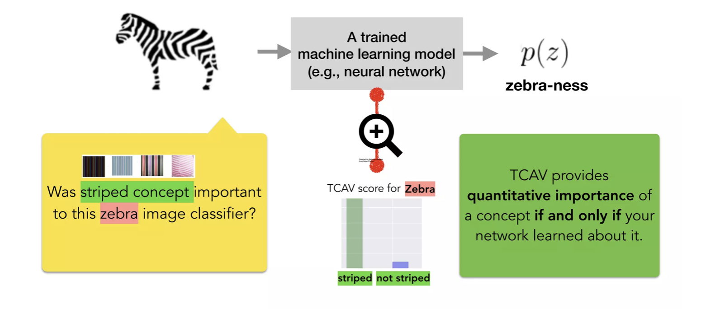

Testing with concept activation vectors
This is the idea behind T-CAV (Testing with concept activation vectors)
How sensitive is the prediction of zebra is to the presence of the concept of “stripes”?
[1] Kim et al. "Interpretability beyond feature attribution: Quantitative testing with concept activation vectors (tcav)." ICML (2018).

Slide 54
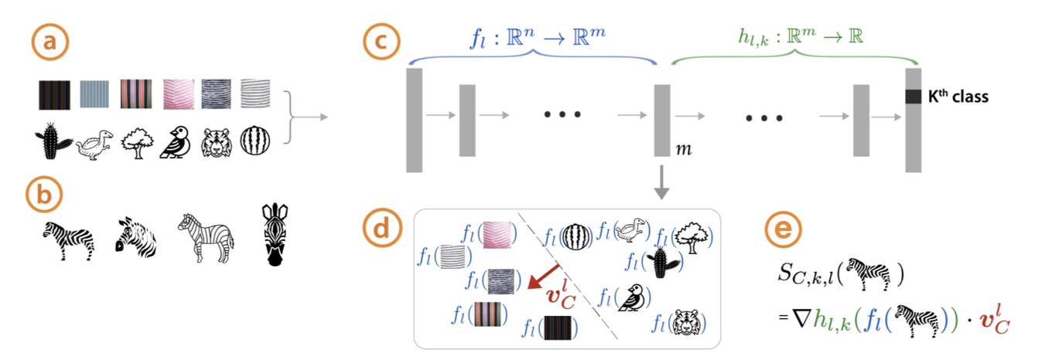

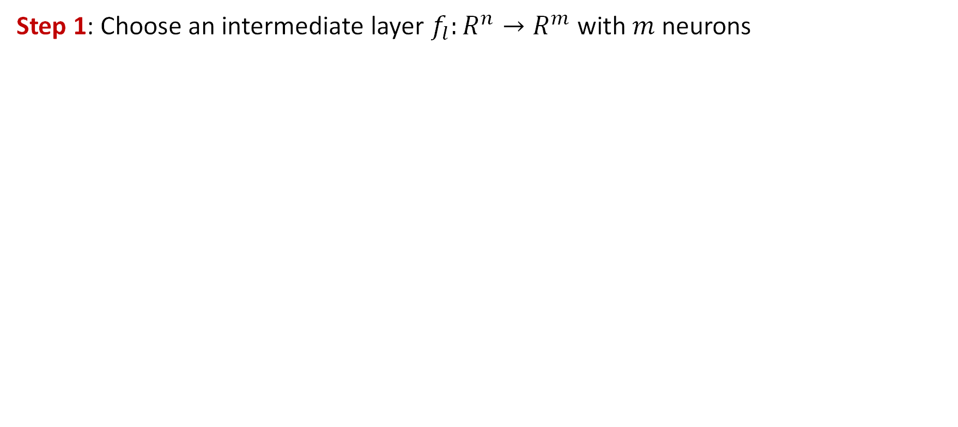
Partitioning the network
Step 1: Choose an intermediate layer $f_{l}:R^{n}→R^{m}$ with $m$ neurons
[1] Kim et al. "Interpretability beyond feature attribution: Quantitative testing with concept activation vectors (tcav)." ICML (2018).

Slide 55



Learning concept activation vectors
Step 2: Learn the Concept Activations Vectors (CAVs)
Train a linear classifier to distinguish between the activations of concept’s examples and random ones
The CAV is the vector orthogonal to the classification boundary $v_{C}^{l}$
set of examples for a concept
and random examples
[1] Kim et al. "Interpretability beyond feature attribution: Quantitative testing with concept activation vectors (tcav)." ICML (2018).
Notes:
This classifier vCl ∈ Rm is a linear CAV for the concept C.
The weight vector w of a logistic regression model is orthogonal to its decision boundary.
The decision boundary is where the model assigns equal probability to both classes.
If wTx is large and positive, the sample is far from the boundary and lies in the positive class region.
If wTx is large and negative, the sample is far from the boundary but in the negative class region.

Slide 56

Testing with CAVs (T-CAV)
Step 3: Given a sample $x$, construct a local importance score $S_{C,k,l}\left(x\right)$ indicating how important concept $C$is for the $k$-th output label.
We want $S_{C,k,l}\left(x\right)$ to capture “how much would the prediction of class $k$ change if I “increase” concept C in sample $x$?”
$$S_{C,k,l}\left(x\right)=\lim_{ε→0}{\frac{h_{l,k}\left(f_{l}\left(x\right)+εv_{C}^{l}\right) −h_{l,k}\left(f_{l}\left(x\right)\right)}{ε}}$$
(Read as: how much would the prediction of label $k$ change if I take a small step in the direction of concept $C$?)
[1] Kim et al. "Interpretability beyond feature attribution: Quantitative testing with concept activation vectors (tcav)." ICML (2018).
Notes:
In other words: how much would $h_{l,k}\left(f_{l}\left(x\right)\right)$ change if I take a small step in the direction of concept c?

Slide 57
Testing with CAVs (T-CAV)
Step 3: Given a sample $x$, construct a local importance score $S_{C,k,l}\left(x\right)$ indicating how important concept $C$is for the $k$-th output label.
We want $S_{C,k,l}\left(x\right)$ to capture “how much would the prediction of class $k$ change if I “increase” concept C in sample $x$?”
This is the same as a directional derivative!
[1] Kim et al. "Interpretability beyond feature attribution: Quantitative testing with concept activation vectors (tcav)." ICML (2018).
Notes:
In other words: how much would $h_{l,k}\left(f_{l}\left(x\right)\right)$ change if I take a small step in the direction of concept c?

Slide 58




Testing with CAVs (T-CAV)
Step 3: Given a sample $x$, construct a local importance score $S_{C,k,l}\left(x\right)$ indicating how important concept $C$is for the $k$-th output label.
Intermediate representation of at layer $l$
$S_{C,k,l}\left(x\right)=∇h_{l,k}\left(f_{l}\left(x\right)\right) . v_{C}^{l}$ = $∇h_{l,k}\left(f_{l}\left( \right)\right) . v_{C}^{l}$
The rate of change of output function as we move in the direction of a concept from data point
Output function
CAV for concept $C$ (e.g., stripes)
Intuition: “high directional derivative” = “large positive change in class label if we ’increase’ $C$ in input $x$”
[1] Kim et al. "Interpretability beyond feature attribution: Quantitative testing with concept activation vectors (tcav)." ICML (2018).

Slide 59


Testing with CAVs (T-CAV)
Step 4: Get a global importance score (T-CAV) for each concept by combining the local sensitivities of samples in an evaluation set:
The T-CAV score is the fraction of samples with label $k$ that are positively influenced by concept $C$
$${TCAV}_{Q_{C,k,l}}= \frac{|\{x∈X_{k}:{ S}_{C,k,l}\left(x\right)>0\}|}{{|X}_{k}|}$$
$X_{k}:$ inputs
with label $k$
[1] Kim et al. "Interpretability beyond feature attribution: Quantitative testing with concept activation vectors (tcav)." ICML (2018).

Slide 60

Example: detecting biases with t-CAV
You can use T-CAV scores to explore/identify model biases
The concept of “female” was found to be significant for predicting the class “Apron”
The concept of “Siberian husky” was found to be significant for predicting the class “Dogsled”
[1] Kim et al. "Interpretability beyond feature attribution: Quantitative testing with concept activation vectors (tcav)." ICML (2018).

Slide 61


T-CAV Limitations
Assuming concepts are linearly separable is a strong and unrealistic assumption
VS
Classes can be linearly separable
While concepts may not be separable
[1] Crabbé et al. "Concept activation regions: A generalized framework for concept-based explanations." NeurIPS (2022).

Slide 62

Concept activation regions
This can be solved by using kernel methods to perform our concept probing on higher-dimensional space where concepts may be separable
[1] Crabbé et al. "Concept activation regions: A generalized framework for concept-based explanations." NeurIPS (2022).
Notes:
(if they form a smooth concept region in the original latent space)

Slide 63

The post-hoc story so far

Slide 64

The post-hoc story so far
Post-hoc methods have a clear set of important limitations:
They may fail to properly explain a model → potentially doubling the source of error!

Slide 65

The post-hoc story so far
Post-hoc methods have a clear set of important limitations:
They may fail to properly explain a model → potentially doubling the source of error!
In fact, these methods often disagree with each other [1]
[1] Krishna et al. "The disagreement problem in explainable machine learning: A practitioner's perspective." TMLR (2022).

Slide 66


The post-hoc story so far
Post-hoc methods have a clear set of important limitations:
Explanations are prone to confirmation bias [1]
Image taken from “Confirmation Bias and the new Malaysia” by Datuk Steven Wong (New Straits Times)
[1] Bertrand et al. "How cognitive biases affect XAI-assisted decision-making: A systematic review." AIES (2022)

Slide 67
Going in-model
Rather than explaining an already trained model, let the model explain itself!
Prediction
Explanation

Slide 68

Going in-model

Slide 69




Aligning machines and humans
M = Machine Representational Space
H = Human Representational Space
$$M−H$$
$$H−M$$
$M∩H$ = Human-like Concepts
[1] Inspired by Schut et al. "Bridging the human-ai knowledge gap: Concept discovery and transfer in alphazero." arXiv (2023).

Slide 70



Aligning machines and humans
M = Machine Representational Space
H = Human Representational Space
$$M−H$$
Concepts
$$H−M$$
$$M∩H$$
[1] Inspired by Schut et al. "Bridging the human-ai knowledge gap: Concept discovery and transfer in alphazero." arXiv (2023).

Slide 71







Concept-based reasoning
Concept-based reasoning can be framed as a Concept Bottleneck Model [1]
$$X$$
$$C$$
$$Y$$
$$P\left(C, Y | X\right)=P\left(C | X\right)P\left(Y | C\right)$$
$X$ = Sample Features
$C$ = Human-interpretable “Concepts”
$Y$ = Target Task Labels
[1] Koh et al. "Concept bottleneck models." International Conference on Machine Learning. PMLR, 2020.

Slide 72



Concept bottleneck Models (CBMs)
CBMs decompose a DNN into two functions:
A concept encoder $g\left(x\right)=\hat{c}$ predicting concepts from the input features
A label predictor $f\left(\hat{c}\right)=\hat{y}$ predicting task labels from the predicted concepts
$$P\left(C | X\right)$$
$$P\left(Y | C\right)$$
[1] Koh et al. "Concept bottleneck models." International Conference on Machine Learning. PMLR, 2020.

Slide 73






Training a CBM
Given a concept-annotated dataset $𝒟={\left\{\left(x^{\left(i\right)}, c^{\left(i\right)}, y^{\left(i\right)}\right)\right\}}_{i=1}^{N}$ we can train a CBM in three different forms:
(1) Independently
(2) Sequentially
(3) Jointly
$$𝔼_{\left(x, c\right)∼𝒟}\left[\text{BCE}\left(g\left(x\right), c\right)\right]$$
(a)
$$𝔼_{\left(x, c\right)∼𝒟}\left[\text{BCE}\left(g\left(x\right), c\right)\right]$$
$$𝔼_{\left(x, c, y\right)∼𝒟}\left[\text{CE}\left(f\left(g\left(x\right)\right), y\right)+ λ⋅\text{BCE}\left(g\left(x\right), c\right)\right]$$
$$𝔼_{\left(c, y\right)∼𝒟}\left[\text{CE}\left(f\left(c\right), y\right)\right]$$
Freeze $g$
(b)
$$𝔼_{\left(x, y\right)∼𝒟}\left[\text{CE}\left(f\left(g\left(x\right)\right), y\right)\right]$$
[1] Koh et al. "Concept bottleneck models." International Conference on Machine Learning. PMLR, 2020.

Slide 74
Concept-level interventions
Concept-based reasoning enables powerful human-AI interactions
Notes:
Kellgren-Lawrence Scale for osteoarthritis (Grade 0 -> Grade 4)

Slide 75
Concept-level interventions
Concept-based reasoning enables powerful human-AI interactions
Notes:
Kellgren-Lawrence Scale for osteoarthritis (Grade 0 -> Grade 4)

Slide 76

Concept Interventions
As we intervene on more concepts, CBM’s test error goes down!
[1] Koh et al. "Concept bottleneck models." International Conference on Machine Learning. PMLR, 2020.

Slide 77

Are CBMs all we need?
CBMs are great in a lot of ways:
They are simple to understand and provide high-level explanations.
They enable test-time interventions that improve their accuracy.
They are very stable, expressive and easy to train.
So, are we done?
Short Answer: No
Long Answer:

Slide 78
Introducing CBM’s Friends
CBMs
Interpretability-accuracy Tradeoff
Ambiguity in concept predictions
Architectural Constraints
Training Constraints
Concept Embedding Models
Probabilistic CBMs
Concept Whitening
Post-hoc CBMs

Slide 79
Speed-dating with CBM’s Friends
CBMs
Interpretability-accuracy Tradeoff
Ambiguity in concept predictions
Architectural Constraints
Training Constraints
Concept Embedding Models
Probabilistic CBMs
Concept Whitening
Post-hoc CBMs

Slide 80



Concept Embedding Models
Limitation Being Addressed
Provided concepts need to be “complete” or else we observe a trade-off!
[1] Espinosa Zarlenga, Barbiero et al. "Concept embedding models: Beyond the accuracy-explainability trade-off." NeurIPS (2022)

Slide 81
Concept Embedding Models
Limitation Being Addressed
Provided concepts need to be “complete” or else we observe a trade-off!
Why can’t we just add a bypass from the input to the output?
[1] Espinosa Zarlenga, Barbiero et al. "Concept embedding models: Beyond the accuracy-explainability trade-off." NeurIPS (2022)

Slide 82

Concept Embedding Models
Limitation Being Addressed
Provided concepts need to be “complete” or else we observe a trade-off!
A “Hybrid” CBM
Why can’t we just add a bypass from the input to the output?
[1] Espinosa Zarlenga, Barbiero et al. "Concept embedding models: Beyond the accuracy-explainability trade-off." NeurIPS (2022)

Slide 83

Concept Embedding Models
Limitation Being Addressed
Provided concepts need to be “complete” or else we observe a trade-off!
A “Hybrid” CBM
Interventions do not necessarily work with Hybrid CBMs!
[1] Espinosa Zarlenga, Barbiero et al. "Concept embedding models: Beyond the accuracy-explainability trade-off." NeurIPS (2022)

Slide 84
Concept Embedding Models
What we want
Similar performance regardless of the number of concepts used during training
Better performance as we intervene in more concepts
“Completeness Agnostic”
“Intervenable”
[1] Espinosa Zarlenga, Barbiero et al. "Concept embedding models: Beyond the accuracy-explainability trade-off." NeurIPS (2022)

Slide 85
Concept Embedding Models
Proposed Solution
We can achieve completeness agnosticism by extending the concept representations to higher-dimensions
[1] Espinosa Zarlenga, Barbiero et al. "Concept embedding models: Beyond the accuracy-explainability trade-off." NeurIPS (2022)

Slide 86

Concept Embedding Models
Proposed Solution
We can achieve completeness agnosticism by extending the concept representations to higher-dimensions
[1] Espinosa Zarlenga, Barbiero et al. "Concept embedding models: Beyond the accuracy-explainability trade-off." NeurIPS (2022)

Slide 87







Concept Embedding Models
Proposed Solution
We can achieve intervenability by decomposing ${\hat{c}}_{i}$as the mixture between two representations $\{{\hat{c}}_{i}^{+}, {\hat{c}}_{i}^{−}\}$:
Concept Embedding Space $ℝ^{m}$
$${\hat{c}}_{i} ≔{\hat{p}}_{i} {\hat{c}}_{i}^{+}+\left(1 −{\hat{p}}_{i}\right) {\hat{c}}_{i}^{−}$$
$${\hat{c}}_{i}^{+}$$
$${\hat{c}}_{i}$$
$${\hat{p}}_{i}$$
$${\hat{c}}_{i}^{−}$$
“Positive” concept embeddings
$${(1 − \hat{p}}_{i})$$
“Negative” concept embeddings
[1] Espinosa Zarlenga, Barbiero et al. "Concept embedding models: Beyond the accuracy-explainability trade-off." NeurIPS (2022)

Slide 88
Concept Embedding Models
Proposed Solution
We can achieve intervenability by decomposing ${\hat{c}}_{i}$as the mixture between two representations $\{{\hat{c}}_{i}^{+}, {\hat{c}}_{i}^{−}\}$:
Concept Embedding Space $ℝ^{m}$
$${\hat{c}}_{i} ≔{\hat{p}}_{i} {\hat{c}}_{i}^{+}+\left(1 −{\hat{p}}_{i}\right) {\hat{c}}_{i}^{−}$$
$${\hat{c}}_{i}^{+}$$
$${\hat{c}}_{i}$$
$${\hat{p}}_{i}$$
$${\hat{c}}_{i}^{−}$$
“Positive” concept embeddings
$${(1 − \hat{p}}_{i})$$
“Negative” concept embeddings
Determining a concept’s activation given ${\hat{c}}_{i}$ then comes down to determining whether ${\hat{c}}_{i}$comes from $P\left({\hat{c}}_{i}^{+}| x\right)$ or $P\left({\hat{c}}_{i}^{−}| x\right)$
[1] Espinosa Zarlenga, Barbiero et al. "Concept embedding models: Beyond the accuracy-explainability trade-off." NeurIPS (2022)

Slide 89

Concept Embedding Models
Proposed Solution
You can then intervene on a concept by fixing its representation to the embedding corresponding to the ground-truth concept label:
$${\hat{c}}_{i} ≔\left\{\begin{aligned}{\hat{c}}_{i}^{+} \text{if} c_{i}=1 \\ {\hat{c}}_{i}^{−}, \text{otherwise}\end{aligned}\right.$$
We can randomly do these interventions at training time to learn more useful representations!
[1] Espinosa Zarlenga, Barbiero et al. "Concept embedding models: Beyond the accuracy-explainability trade-off." NeurIPS (2022)

Slide 90
Concept Embedding Models
Proposed Solution
Learn two functions $(φ_{i}^{+}, φ_{i}^{−})$mapping $x$ to a positive ${\hat{c}}_{i}^{+}$ and a negative embedding ${\hat{c}}_{i}^{−}$
$$P\left(c_{i}=1 | x\right)=s\left({\hat{c}}_{i}^{+},{\hat{c}}_{i}^{−}\right)=σ\left(S {\left[{\hat{c}}_{i}^{+},{\hat{c}}_{i}^{−}\right]}^{T} \right)$$
[1] Espinosa Zarlenga, Barbiero et al. "Concept embedding models: Beyond the accuracy-explainability trade-off." NeurIPS (2022)

Slide 91



Concept Embedding Models
Proposed Solution
This gives you models that are completeness agnostic and intervenable*
RandInt is important!
*This is particularly true when, during training, you randomly intervene** on a concept with probability $p_{int}$.
** These sorts of training-time interventions are useful here only because by using embeddings, we can backpropagate gradients to the concept encoder even when a concept is intervened on (a CBM wouldn’t).

Slide 92
Speed-dating with CBM’s Friends
CBMs
Interpretability-accuracy Tradeoff
Ambiguity in concept predictions
Architectural Constraints
Training Constraints
Concept Embedding Models
Probabilistic CBMs
Concept Whitening
Post-hoc CBMs

Slide 93


Concept Whitening (CW)
Limitation Being Addressed
Training a CBM has impractical architectural constraints and requires all training samples to be concept annotated!
This limits our ability to exploit powerful pre-trained models
[1] Chen et al. "Concept whitening for interpretable image recognition." Nature Machine Intelligence 2.12 (2020).

Slide 94
Interpretable-by-design neural layer
Proposed Solution
Design an interpretable-by-design layer which we can use to replace an equivalent component in a pre-trained model and quickly fine-tune it to make it interpretable
We will target the commonly used Batch Normalization (BN) layer
[1] Chen et al. "Concept whitening for interpretable image recognition." Nature Machine Intelligence 2.12 (2020).

Slide 95

Whitening for disentangling concepts
Intuition
Normalization can somewhat help disentangle concepts in a DNN’s latent space
neuron 1
neuron 1
neuron 2
neuron 2
Activation Space
Standardized Space
[1] Chen et al. "Concept whitening for interpretable image recognition." Nature Machine Intelligence 2.12 (2020).

Slide 96
Whitening for disentangling concepts
Intuition
Whitening a latent space can allow us to properly separate concepts in the latent space
neuron 1
neuron 1
neuron 1
Solution
neuron 2
neuron 2
neuron 2
Activation Space
Standardized Space
Whitened Space
[1] Chen et al. "Concept whitening for interpretable image recognition." Nature Machine Intelligence 2.12 (2020).

Slide 97



Rotating to ensure concept alignment
Approach
More importantly, once an input is whitened, we can apply a rotation to align a specific concept to a specific axis!
Normalize
Whiten
Rotate
[1] Chen et al. "Concept whitening for interpretable image recognition." Nature Machine Intelligence 2.12 (2020).

Slide 98

Concept whitening (CW)
Approach
Given a fine-tuning training set $𝒟_{t}={\left\{\left(x^{\left(i\right)}, y^{\left(i\right)}\right)\right\}}_{i}$ and $k$ concept sets $𝒟_{c}=\left\{X_{C_{1}},X_{C_{2}}, ⋯,X_{C_{k}}\right\}$, we will learn a rotation matrix $Q∈ℝ^{m×m}$ by iterating between:
Task training step → make sure the downstream task prediction is accurate
Concept alignment step → make sure each concept is aligned to a latent activation

Slide 99













Training cw: Task training step
“Partial” Concept Bottleneck
$$\vec{\hat{y}}$$
Main Dataset
$$\vec{z}$$
$$\vec{z}′$$
Whitening
$$\vec{x}$$
$$Φ_{θ}\left(\vec{x}\right)$$
$$ψ_{\left(W, μ\right)}\left(\vec{z}\right)$$
$$×$$
$$g_{ω}\left(\vec{z}′\right)$$
$$ℒ\left(\vec{\hat{y}}, \vec{y}\right)$$
$$Q$$
Rotation Matrix
$$\vec{y}$$
(Frozen)
$ψ_{\left(W, μ\right)}\left(\vec{z}\right)=W\left(\vec{z} −\vec{μ}\right)$
ZCA-Whitening matrix $W=Σ^{−\frac{1}{2}}$ via IterNorm
Notes:
Mention that during training we keep track of mu and W for us to use those values during inference.
When applied to convolutions, we use the activation of a whole feature map to indicate the existance of a concept. In order to get a scalar score, they employ a mean of down-sampled feature map obtained by max pooling.
IterNorm performs ZCA whitening by running several Newton method steps to construct this matrix without the need for eigenvalue decomposition
Change colors of activation
Move arrow down

Slide 100










Training cw: concept alignment step
Maximize effect of aligning the j-th activation with samples from the j-th concept
Auxiliary Datasets
$$\vec{z}$$
Whitening
$$X_{C_{1}}$$
$$X_{C_{2}}$$
$$Φ_{θ}\left(\vec{x}\right)$$
$$ψ_{\left(W, μ\right)}\left(\vec{z}\right)$$
$$×$$
$$X_{C_{3}}$$
$$X_{C_{4}}$$
$$Q$$
Rotation Matrix
keep the Q matrix orthogonal
(Learnable!)
Notes:
The optimization problem is solved using gradient methods on the Stiefel manifold (manifold of k-orthogonal tensors)
- To do so, we use the Cayley transform in an iterative manner to update our estimate of Q. Note that this brings a lot of possible solutions (and saddle points) so using SGD helps to avoid them

Slide 101

Found prototypes
CW supports the hypothesis that DNNs learn more complex concepts in later layers:
[1] Chen et al. "Concept whitening for interpretable image recognition." Nature Machine Intelligence 2.12 (2020).

Slide 102
Speed-dating with CBM’s Friends
CBMs
Interpretability-accuracy Tradeoff
Ambiguity in concept predictions
Architectural Constraints
Training Constraints
Concept Embedding Models
Probabilistic CBMs
Concept Whitening
Post-hoc CBMs

Slide 103

Post-hoc CBMs
Limitation Being Addressed
CW is great but is has some key limitations:
It requires a batch norm layer in the pretrained model (read: architecture-specific)
It requires fine-tuning of all the of the model’s weights (read: could be expensive)
[1] Yuksekgonul et al. "Post-hoc concept bottleneck models." ICLR (2023).

Slide 104


Post-hoc CBMs
Proposed Solution
Given a bank of concept activation vectors in a pre-trained model, we learn an interpretable mapping projected concept scores and a downstream task of interest
A trained DNN
Concept Activation Vector Bank
Post-hoc CBMs!
+
=
[1] Yuksekgonul et al. "Post-hoc concept bottleneck models." ICLR (2023).

Slide 105
Post-hoc CBMs
Proposed Solution
Goal: learn an interpretable model mapping concept similarity scores to task labels
Make the final prediction with an interpretable predictor
Step 1: learn CAVs from the frozen latent space of the pre-trained DNN
[1] Yuksekgonul et al. "Post-hoc concept bottleneck models." ICLR (2023).

Slide 106
Post-hoc CBMs
Proposed Solution
Goal: learn an interpretable model mapping concept similarity scores to task labels
Step 2: project all training samples to the concept activation space using the cavs
[1] Yuksekgonul et al. "Post-hoc concept bottleneck models." ICLR (2023).

Slide 107
Post-hoc CBMs
Proposed Solution
Goal: learn an interpretable model mapping concept similarity scores to task labels
Step 3: learn an interpretable predictor from the concept scores to the task labels
[1] Yuksekgonul et al. "Post-hoc concept bottleneck models." ICLR (2023).

Slide 108
Post-hoc CBMs
Proposed Solution
Goal: learn an interpretable model mapping concept similarity scores to task labels
If the concepts are incomplete, the performance will drop significantly!
Step 3: learn an interpretable predictor from the concept scores to the task labels
[1] Yuksekgonul et al. "Post-hoc concept bottleneck models." ICLR (2023).

Slide 109
Post-hoc CBMs
Proposed Solution
Goal: learn an interpretable model mapping concept similarity scores to task labels
Step 4 (optional): fit a residual model if the concepts are incomplete
[1] Yuksekgonul et al. "Post-hoc concept bottleneck models." ICLR (2023).

Slide 110
Post-hoc CBMs without concept sets
Post-hoc CBMs can be learnt without concept sets if we have access to language-based concepts together with a multimodal model
[1] Yuksekgonul et al. "Post-hoc concept bottleneck models." ICLR (2023).

Slide 111
Speed-dating with CBM’s Friends
CBMs
Interpretability-accuracy Tradeoff
Ambiguity in concept predictions
Architectural Constraints
Training Constraints
Concept Embedding Models
Probabilistic CBMs
Concept Whitening
Post-hoc CBMs

Slide 112


Probabilistic CBMs
Limitation being addressed
CBMs must predict concepts for all samples even they are ambiguous
The cross-entropy loss does not encourage the concept predictor to be uncertain
[1] Kim et al. "Probabilistic Concept Bottleneck Models." ICML (2023).

Slide 113

Probabilistic CBMs
Proposed Solution
Use probabilistic embeddings that enable uncertainty estimation of each concept!
Learn a distribution over concept embeddings and use its variance to estimate uncertainty
[1] Kim et al. "Probabilistic Concept Bottleneck Models." ICML (2023).

Slide 114

Probabilistic CBMs
Proposed Solution
Each Probabilistic Embedding Module (PEM) generates a mean $μ_{c_{i}}$ and a variance $σ_{c_{i}}$for the concept embedding
[1] Kim et al. "Probabilistic Concept Bottleneck Models." ICML (2023).

Slide 115
Probabilistic CBMs
Proposed Solution
We learn a set of fixed anchor embeddings representing the concept when it is on vs off
“Anchor” embedding representing the concept when it is “on”
“Anchor” embedding representing the concept when it is “off”
[1] Kim et al. "Probabilistic Concept Bottleneck Models." ICML (2023).

Slide 116

Probabilistic CBMs
Proposed Solution
The distance from the sampled embedding to each anchor can be used to predict a concept
$$p\left(c=1 | z_{c}\right)=σ\left(a\left({\left|\left|z_{c}−z_{c}^{−}\right|\right|}_{2}−{\left|\left|z_{c}−z_{c}^{+}\right|\right|}_{2}\right)\right)$$
[1] Kim et al. "Probabilistic Concept Bottleneck Models." ICML (2023).

Slide 117
Probabilistic CBMs
Proposed Solution
A concept’s distribution’s volume can be used to quantify its uncertainty
As embeddings are modelled as Gaussians, this is the determinant of the covariance!
[1] Kim et al. "Probabilistic Concept Bottleneck Models." ICML (2023).

Slide 118
End of the speed dates!
CBMs
Interpretability-accuracy Tradeoff
Ambiguity in concept predictions
Architectural Constraints
Training Constraints
Concept Embedding Models
Probabilistic CBMs
Concept Whitening
Post-hoc CBMs

Slide 119
Do CBms properly learn to explain?

Slide 120



Do CBms properly learn to explain?
Several recent works suggest CBMs may have issues with unwanted leakage
Attending spurious features
Leaking unwanted information
Failing to capture concept locality
Saliency maps seem to suggest concepts are not properly attended
(Margeloiu et al.) [1]
CBMs may have incentives to encode the entire data representation in the concepts’ soft predictions
(Mahinpei et al.) [2]
CBMs may fail to capture a concept’s locality (e.g., physical location) even if it is only found on a fixed feature subset
(Raman et al.) [3]
[1] Margeloiu et al. "Do concept bottleneck models learn as intended?." ICLR Workshop on Responsible AI (2021).
[2] Mahinpei et al. "Promises and pitfalls of black-box concept learning models." ICML Workshop on Theoretic Foundation, Criticism, and Application of XAI (2021).
[3] Raman et al. "Do Concept Bottleneck Models Respect Localities?." NeurIPS Workshop on XAI in Action (2024).

Slide 121





Do CBms properly learn to explain?
Many more works have dived deeper into these issues!
Adversarial attacks and defences
Studying concept correlations
Formalisms and metrics for leakage
Metrics for unwanted leakage [3]
Benchmark suite for reasoning robustness [4]
Formalisation of leakage [5]
CBMs concepts predictions can be changed without affecting the final prediction
(Sinha et al.) [1]
Simple changes to the loss, like loss weighting, can help avoid CBMs exploiting unwanted correlations
(Heidenmann et al.) [2]
Several works proposed ways to formalise or measure concept leakage [3, 4, 5]
[1] Sinha et al. "Understanding and enhancing robustness of concept-based models." AAAI (2023).
[2] Heidemann et al. "Concept correlation and its effects on concept-based models." WACV (2023).
[3] Espinosa Zarlenga, Barbiero, Shams et al. "Towards robust metrics for concept representation evaluation." AAAI (2023).
[4] Bortolotti, Marconato, et al. "A Neuro-Symbolic Benchmark Suite for Concept Quality and Reasoning Shortcuts." NeurIPS (2024).
[5] Marconato et al. "Interpretability is in the mind of the beholder: A causal framework for human-interpretable representation learning." Entropy (2023).

Slide 122




Steps towards addressing leakage
This have brought forth attempts to address or mitigate the effects of leakage:
GlanceNets
Autoregressive CBMs
[Main Idea] Frame leakage in terms of disentanglement learning and use an open-set recognition to detect it at inference
[Main Idea] Reduce leakage between concepts by modeling cross-concept relationships using an autoregressive architecture
[1] Marconato et al. "Glancenets: Interpretable, leak-proof concept-based models." NeurIPS (2022).
[2] Havasi et al. "Addressing leakage in concept bottleneck models." NeurIPS (2022).

Slide 123
Recent directions
CBMs have become very popular in XAI with several active areas of research:

Slide 124


Recent directions
CBMs have become very popular in XAI with several active areas of research:
Capturing more complex relationships between concepts and tasks labels
Energy-based Concept Bottleneck Models (Xu et al., 2024)
[1] Xu et al. "Energy-based concept bottleneck models: unifying prediction, concept intervention, and conditional interpretations." ICLR (2024).

Slide 125


Recent directions
CBMs have become very popular in XAI with several active areas of research:
Capturing more complex relationships between concepts and tasks labels
Producing entirely language-based bottlenecks (accepted to this AAAI!)
Explanation Bottleneck Models (Yamaguchi et al.)
[1] Yamaguchi et al. "Explanation Bottleneck Models." AAAI (2025).

Slide 126








Recent directions
CBMs have become very popular in XAI with several active areas of research:
Capturing more complex relationships between concepts and tasks labels
Producing entirely language-based bottlenecks (accepted to this AAAI!)
Exploring concepts in modalities and tasks other than supervised visual tasks
Graph Data
(e.g., Xuanyuan et al.)
Tabular Data
(e.g., Espinosa Zarlenga et al.)
RL Tasks
(e.g., Ye et al.)
Time Series Data
(e.g., Kazhdan et al.)
[1] Xuanyuan al. "Global concept-based interpretability for graph neural networks via neuron analysis." AAAI (2023).
[2] Espinosa Zarlenga et al. "Tabcbm: Concept-based interpretable neural networks for tabular data." TMLR (2024).
[3] Ye et al. "Concept-based interpretable reinforcement learning with limited to no human labels." ICML (2024).
[4] Kazhdan et al. "MEME: generating RNN model explanations via model extraction." arXiv (2020).

Slide 127
Tutorial outline
Introduction
Supervised Concept Learning
Concept Interventions
Q&A + Break
Unsupervised Concept Learning
Reasoning With Concepts
Future Directions
Q&A

Slide 128
Recall concept interventions
Concept interventions enable experts to “inject” knowledge during inference

Slide 129


Some concepts are better than others
When intervening on a CBM, it is important to realise that some concepts are:
Less informative than others (e.g., redundant w.r.t. other concepts)
Less certain than others (e.g., due to occlusions or inherent difficulties)
Concept “Belly Color” is partially occluded
To identify a Raven from a Crow, “tail shape” is more informative than “wing color”
[1] mage taken from Leah Lin , “How to Identify a Crow and a Raven: Key Features Explained” Birdfy (2024).

Slide 130
Some concepts are better than others
When intervening on a CBM, it is important to realise that some concepts are:
Less informative than others (e.g., redundant w.r.t. other concepts)
Less certain than others (e.g., due to occlusions or inherent difficulties)
Hence, an intervention’s effectiveness depends on the intervened concept!

Slide 131



Selecting meaningful concepts
Intervention policies select which concept to intervene on next by assigning each concept $c_{i}$a score $s_{i}$ and selecting concepts in decreasing score order:
Given $x$ and concept predictions $\hat{c}$, what concept should I intervene on next to minimize my model’s task uncertainty?
[1] Shin et al. ”A Closer Look at the Intervention Procedure of Concept Bottleneck Models." ICML 2023.

Slide 132

Selecting meaningful concepts
Intervention policies select which concept to intervene on next by assigning each concept $c_{i}$a score $s_{i}$ and selecting concepts in decreasing score order:
Uncertainty of concept prediction (UCP)
Select the concept $c_{i}$with the highest predicted entropy $s_{i}=ℋ\left({\hat{c}}_{i}\right)$
[1] Shin et al. ”A Closer Look at the Intervention Procedure of Concept Bottleneck Models." ICML 2023.

Slide 133


Selecting meaningful concepts
Intervention policies select which concept to intervene on next by assigning each concept $c_{i}$a score $s_{i}$ and selecting concepts in decreasing score order:
Uncertainty of concept prediction (UCP)
Contribution of concept on target prediction (CCTP)
Select the concept $c_{i}$with the highest predicted entropy $s_{i}=ℋ\left({\hat{c}}_{i}\right)$
Select the concept $c_{i}$with the highest contribution on target prediction $s_{i}=\sum_{j=1}^{L}{\left|{\hat{c}}_{i}\frac{∂f_{j}\left(x\right)}{∂{\hat{c}}_{i}}\right|}$.
[1] Shin et al. ”A Closer Look at the Intervention Procedure of Concept Bottleneck Models." ICML 2023.

Slide 134


Selecting meaningful concepts
Intervention policies select which concept to intervene on next by assigning each concept $c_{i}$a score $s_{i}$ and selecting concepts in decreasing score order:
Uncertainty of concept prediction (UCP)
Contribution of concept on target prediction (CCTP)
Select the concept $c_{i}$with the highest predicted entropy $s_{i}=ℋ\left({\hat{c}}_{i}\right)$
Select the concept $c_{i}$with the highest contribution on target prediction $s_{i}=\sum_{j=1}^{L}{\left|{\hat{c}}_{i}\frac{∂f_{j}\left(x\right)}{∂{\hat{c}}_{i}}\right|}$.
Expected change in target prediction (ECTP)
Select the concept $c_{i}$with the highest expected change in the target predictive distribution $s_{i}=\left(1 −{\hat{c}}_{i}\right)D_{KL}\left({\hat{y}}_{{\hat{c}}_{i}=0}||\hat{y}\right)+{\hat{c}}_{i}D_{KL }\left({\hat{y}}_{{\hat{c}}_{i}=1}||\hat{y}\right)$
[1] Shin et al. ”A Closer Look at the Intervention Procedure of Concept Bottleneck Models." ICML 2023.

Slide 135
Selecting meaningful concepts
Intervention policies select which concept to intervene on next by assigning each concept $c_{i}$a score $s_{i}$ and selecting concepts in decreasing score order:
Uncertainty of concept prediction (UCP)
Contribution of concept on target prediction (CCTP)
Select the concept $c_{i}$with the highest predicted entropy $s_{i}=ℋ\left({\hat{c}}_{i}\right)$
Select the concept $c_{i}$with the highest contribution on target prediction $s_{i}=\sum_{j=1}^{L}{\left|{\hat{c}}_{i}\frac{∂f_{j}\left(x\right)}{∂{\hat{c}}_{i}}\right|}$.
Expected change in target prediction (ECTP)
Select the concept $c_{i}$with the highest expected change in the target predictive distribution $s_{i}=\left(1 −{\hat{c}}_{i}\right)D_{KL}\left({\hat{y}}_{{\hat{c}}_{i}=0}||\hat{y}\right)+{\hat{c}}_{i}D_{KL }\left({\hat{y}}_{{\hat{c}}_{i}=1}||\hat{y}\right)$
One can think of these policies as proxies for a concept’s information content and certainty
[1] Shin et al. ”A Closer Look at the Intervention Procedure of Concept Bottleneck Models." ICML 2023.

Slide 136

Intervention policies results
This leads to significantly different intervention curves:
Best performing non-oracle policy is Expected change in target prediction (ECTP) but even the simple Uncertainty of concept prediction (UCP) is significantly better than the random policy (RAND)
(Intuition: one should select the concept leading to the highest expected change in the task’s distribution)
[1] Shin et al. ”A Closer Look at the Intervention Procedure of Concept Bottleneck Models." ICML 2023.

Slide 137
Intervention policies results
This leads to significantly different intervention curves:
We still observe a significant gap between the best policy and an optimal greedy policy (LCP)
[1] Shin et al. ”A Closer Look at the Intervention Procedure of Concept Bottleneck Models." ICML 2023.

Slide 138

Combining policies
It may be possible to shorten this gap by learning a weighting between the concept uncertainty and the expected change in current prediction policies
Cooperative Prediction Intervention Policy (CooP)
$$s_{i}=αℋ\left({\hat{c}}_{i}\right)+β\left|E_{v∼p\left(c_{i} | x\right)}\left[{\hat{y}}_{{\hat{c}}_{i}=v} −\hat{y}\right]\right|+γq_{i}$$
[1] Chauhan et al. "Interactive concept bottleneck models." AAAI (2023).

Slide 139
Combining policies
It may be possible to shorten this gap by learning a weighting between the concept uncertainty and the expected change in current prediction policies
Cooperative Prediction Intervention Policy (CooP)
$$s_{i}=αℋ\left({\hat{c}}_{i}\right)+β\left|E_{v∼p\left(c_{i} | x\right)}\left[{\hat{y}}_{{\hat{c}}_{i}=v} −\hat{y}\right]\right|+γq_{i}$$
Uncertainty of concept prediction
Cost of the intervention
Expected change to the current predicted label if we were to intervene on c_i based on c_i’s current prediction
[1] Chauhan et al. "Interactive concept bottleneck models." AAAI (2023).

Slide 140
Combining policies
It may be possible to shorten this gap by selecting concepts based on both the concept uncertainty and the expected change in current prediction
Can we do any better than this? Can we avoid the need for calculating computationally expensive scores all concepts?
Cooperative Prediction Intervention Policy (CooP)
$$s_{i}=αℋ\left({\hat{c}}_{i}\right)+β\left|E_{v∼p\left(c_{i} | x\right)}\left[{\hat{y}}_{{\hat{c}}_{i}=v} −\hat{y}\right]\right|+γq_{i}$$
We can find the hyperparameters $α$, $β$, and $γ$ using a concept-annotated validation set
[1] Chauhan et al. "Interactive concept bottleneck models." AAAI (2023).

Slide 141


insight #1: training-time incentives
There is a disconnect between how CBMs are trained and how they are used at test-time when they are intervened on
Train-time
Test-time
Predict task labels from a set of entirely predicted concepts
Predict task labels from a set of concepts where some are ground-truth labels and others are predicted
$$≠$$
During training, concept-based models are not even aware they may be intervened on!
During testing, concept interventions may lead to out-of-distribution bottlenecks for a CBM!
[1] Espinosa Zarlenga et al. "Learning to receive help: Intervention-aware concept embedding models." NeurIPS (2023)

Slide 142
insight #2: useful training feedback
If we know all task and concept labels, we can compute the optimal greedy concept intervention:
(Translation: Attempt every intervention and select that one maximises the ground truth label’s confidence)
This is feedback we have at training time and can use to learn an intervention policy!
[1] Espinosa Zarlenga et al. "Learning to receive help: Intervention-aware concept embedding models." NeurIPS (2023)

Slide 143

insight #3: interventions can be differentiable
When modelling concepts as being a mixture of two learnable embeddings $\left\{c_{i}^{+ },c_{i}^{− }\right\}$ as in CEMs, interventions are differentiable:
Original Embedding Construction
$${\hat{c}}_{i} ≔\hat{p_{i}}{\hat{c}}_{i}^{+}+\left(1 −\hat{p_{i}}\right) {\hat{c}}_{i}^{−}$$
Intervened Embedding Construction
$${\hat{c}}_{i} ≔\left(μ_{i}c_{i}+\left(1 −μ_{i}\right)\hat{p_{i}}\right) {\hat{c}}_{i}^{+}+\left(1 −\left(μ_{i}c_{i}+\left(1 −μ_{i}\right){\hat{p}}_{i}\right)\right) {\hat{c}}_{i}^{−}$$
Whether we intervene on the $i$-th concept (can be relaxed to be in [0,1])
[1] Espinosa Zarlenga et al. "Learning to receive help: Intervention-aware concept embedding models." NeurIPS (2023)

Slide 144
insight #3: interventions can be differentiable
When modelling concepts as being a mixture of two learnable embeddings $\left\{c_{i}^{+ },c_{i}^{− }\right\}$ as in CEMs, interventions are differentiable:
Original Embedding Construction
$${\hat{c}}_{i} ≔\hat{p_{i}}{\hat{c}}_{i}^{+}+\left(1 −\hat{p_{i}}\right) {\hat{c}}_{i}^{−}$$
Intervened Embedding Construction
$${\hat{c}}_{i} ≔\left(μ_{i}c_{i}+\left(1 −μ_{i}\right)\hat{p_{i}}\right) {\hat{c}}_{i}^{+}+\left(1 −\left(μ_{i}c_{i}+\left(1 −μ_{i}\right){\hat{p}}_{i}\right)\right) {\hat{c}}_{i}^{−}$$
Whether we intervene on the $i$-th concept (can be relaxed to be in [0,1])
This means an intervention policy deciding $μ_{i}$can be learnt via gradient descent!
[1] Espinosa Zarlenga et al. "Learning to receive help: Intervention-aware concept embedding models." NeurIPS (2023)

Slide 145
Intervention-aware models
Intervention-Aware Concept Embedding Models (IntCEMs) incorporate these insights into an end-to-end architecture that:
Introduces an intervention-aware training loss that encourages receptiveness to concept interventions at test-time
Learns an efficient intervention policy in an end-to-end fashion.
[1] Espinosa Zarlenga et al. "Learning to receive help: Intervention-aware concept embedding models." NeurIPS (2023)

Slide 146

How to train your intcem?
This can be done using an end-to-end neural architecture:
[1] Espinosa Zarlenga et al. "Learning to receive help: Intervention-aware concept embedding models." NeurIPS (2023)

Slide 147
How to train your intcem?
This can be done using an end-to-end neural architecture:
(1) Construct a positive and negative embedding for each training concept

Slide 148
How to train your intcem?
This can be done using an end-to-end neural architecture:
(2) Randomly select a subset of concepts which we will initially intervene on and a number of interventions $T$ we will perform in this training step

Slide 149
How to train your intcem?
This can be done using an end-to-end neural architecture:
(3) Recursively sample a trajectory of T interventions from this set using a learnable intervention policy. We train this policy to align to the “oracle” optimal policy.

Slide 150
How to train your intcem?
This can be done using an end-to-end neural architecture:
(4) Penalise the model more heavily for mispredicting the task label at the end of the intervention trajectory vs mispredicting the task label at the start of the trajectory
$𝔼_{\left(x, c, y\right)∼𝒟}\left[\frac{ℒ_{task}\left(y, f\left({\hat{c}}^{(0)}\right)\right)+γ^{T}ℒ_{task}\left(y, f\left({\hat{c}}^{(T)}\right)\right)}{1+γ^{T}}\right]$

Slide 151
What does all of this give you?

Slide 152

What does all of this give you?
(1) A model that is much better at receiving test-time feedback even if concepts are intervened in a random order
IntCEM
IntCEM
Up to 9% in absolute improvement when 25% of concepts are randomly selected to be intervened on!

Slide 153

What does all of this give you?
(2) An efficient intervention policy that selects useful concepts to intervene on next
IntCEM’s Policy!
IntCEM’s Policy!

Slide 154

Critical limitations of interventions
When intervening, we assume that concept interventions are:
Transient: after an intervention is made, it is forgotten
If an intervention is made on a sample $x$
The same mistake will be made if $x$is seen again
Some time later…

Slide 155

Critical limitations of interventions
When intervening, we assume that concept interventions are:
Transient: after an intervention is made, it is forgotten
Independent: intervening on concept $c_{i}$ will not affect other concepts’ values

Slide 156









Relaxing key assumptions
These constraints can be relaxed via clever modelling:
Concept Bottleneck Memory Models
Stochastic Concept Bottleneck Models
$$∼$$
$$𝒩\left( , \right)$$
$$σ^{−1}\left(\hat{c}\right)$$
$$μ\left(x\right)$$
$$Σ\left(x\right)$$
Addresses: Transient nature of a concept intervention
Approach: Introduce a learnable memory module that keeps previously seen interventions and re-applies them in the future,
Addresses: the assumption that concepts are independent
Approach: Model the predicted concept logits as a normal distribution with a (learnable) non-diagonal covariance.
[1] Steinmann et al. "Learning to Intervene on Concept Bottlenecks." ICML (2024).
[2] Vandenhirtz, Laguna et al. "Stochastic Concept Bottleneck Models." NeurIPS (2024).

Slide 157

Can interventions extend beyond CBMs?
So far, the concept intervention strategies we have considered require one to operate on a CBM-like model
Could we potentially extend these ideas to models beyond CBMs?
[1] Laguna, Marcinkevǐcs, et al. "Beyond Concept Bottleneck Models: How to Make Black Boxes Intervenable?." NeurIPS (2024).

Slide 158




Injecting knowledge to black boxes
Given a black-box model $f_{θ}\left(x\right)=g_{ψ}\left(h_{φ}\left(x\right)\right)$ and a test sample $x$, we may want to inject knowledge about the presence or absence of a concept in $x$at test time
There are cysts in that image
$$x$$
$$f_{θ}\left(x\right)$$
$$\hat{y}$$
[1] Laguna, Marcinkevǐcs, et al. "Beyond Concept Bottleneck Models: How to Make Black Boxes Intervenable?." NeurIPS (2024).

Slide 159

Injecting knowledge to black boxes
Given a black-box model $f_{θ}\left(x\right)=g_{ψ}\left(h_{φ}\left(x\right)\right)$ and a test sample $x$, we may want to inject knowledge about the presence or absence of a concept in $x$at test time
If we have a concept-annotated validation set ${\left\{\left(x^{\left(i\right)}, c^{\left(i\right)}, y^{i}\right)\right\}}_{i}$, we can do this!
[1] Laguna, Marcinkevǐcs, et al. "Beyond Concept Bottleneck Models: How to Make Black Boxes Intervenable?." NeurIPS (2024).

Slide 160


Black-box intervenability: probing
We first learn a multivariate probe $\hat{c}=ξ\left(z\right)$that predicts all concepts given the latent space $z=h_{φ}\left(x\right)$ using the annotated validation set
[1] Laguna, Marcinkevǐcs, et al. "Beyond Concept Bottleneck Models: How to Make Black Boxes Intervenable?." NeurIPS (2024).

Slide 161





Black-box intervenability: Editing
Given user-provided concept labels $c^{′}$ for sample $x$, we edit the representation $z=h_{φ}\left(x\right)$ so that it maps to $c^{′}$as predicted by the probe $ξ\left(z\right)$
We find a new latent representation $z^{′}$ by solving
Concept alignment
Make the latent representation map to the set of user-provided concepts $c^{′}$
Distance Penalty
Keep the new latent representation as close as possible to the original
[1] Laguna, Marcinkevǐcs, et al. "Beyond Concept Bottleneck Models: How to Make Black Boxes Intervenable?." NeurIPS (2024).

Slide 162

Black-box intervenability: output
Finally, fed the edited representation $z^{′}$ to the second part of the DNN to obtain an updated prediction $\hat{y^{′}}=g_{ψ}\left(z′\right)$
[1] Laguna, Marcinkevǐcs, et al. "Beyond Concept Bottleneck Models: How to Make Black Boxes Intervenable?." NeurIPS (2024).

Slide 163

What this gives you
This process allows you to improve the task accuracy of a black-box model when you have extra test-time knowledge in the form of concepts labels
AUPR (AwA)
More importantly, you can fine-tune a model to be more receptive to this type of interventions by directly optimizing for an edit’s positive effect
[1] Laguna, Marcinkevǐcs, et al. "Beyond Concept Bottleneck Models: How to Make Black Boxes Intervenable?." NeurIPS (2024).

Slide 164
Tutorial outline
Introduction
Supervised Concept Learning
Concept Interventions
Q&A + Break
Unsupervised Concept Learning
Reasoning With Concepts
Future Directions
Q&A
(Back at 16:15!)

Slide 165
Q&A + Break
conceptlearning.github.io/ Back at 16:15 for part II!

Slide 166
Tutorial outline
Introduction
Supervised Concept Learning
Concept Interventions
Q&A + Break
Unsupervised Concept Learning
Reasoning With Concepts
Future Directions
Q&A

Slide 167

The cost of being great
What if you don’t have access to concept supervisions?

Slide 168

The cost of being great
What if you don’t have access to concept supervisions?

Slide 169
The cost of being great
T-CAV requires large sets of examples of each concept of interest:
For example, when finding the influence of the concept “stripes” for a DNN, T-CAV requires a set of samples that all have the concept “stripes”
But, obtaining concept labels can be expensive and intractable

Slide 170
The cost of being great
T-CAV requires large sets of examples of each concept of interest:
Can we extract patches automatically?
For example, when finding the influence of the concept “stripes” for a DNN, T-CAV requires a set of samples that all have the concept “stripes”
But, obtaining concept labels can be expensive and intractable

Slide 171









Automatic Concept Extraction (ACE)
Desiderata: We would like to discover concepts / patches that are:
Meaningful
Coherent
Important
$$( )$$
$$≠$$
“Car”
$$∼f$$
“Wheel”
$$≠$$
“Mirror”
“Wheel”
[1] Ghorbani et al. "Towards automatic concept-based explanations." Advances in Neural Information Processing Systems 32 (2019).

Slide 172

Automatic Concept Extraction (ACE)
Proposed Solution
Step 1: Multi-resolution segmentation (why? concepts have different granularities)
Desiderata enforced: meaningfulness
[1] Ghorbani et al. "Towards automatic concept-based explanations." Advances in Neural Information Processing Systems 32 (2019).
Notes:
Mention that the purpose of the multi-resolution algo is to be able to capture concept at different granularities.

Slide 173
Automatic Concept Extraction (ACE)
Proposed Solution
Step 2: cluster extracted segments using a hidden layer (which one?) of a CNN as a feature extractor (why? ensure invariances). Then get rid of outliers (why? noisy!).
Desiderata enforced: coherence
[1] Ghorbani et al. "Towards automatic concept-based explanations." Advances in Neural Information Processing Systems 32 (2019).
Notes:
Mention that the purpose of the multi-resolution algo is to be able to capture concept at different granularities.

Slide 174
Automatic Concept Extraction (ACE)
Proposed Solution
Step 3: use T-CAV with the newly discovered concepts to explain the prediction
of the sample of interest!
Desiderata enforced: importance
[1] Ghorbani et al. "Towards automatic concept-based explanations." Advances in Neural Information Processing Systems 32 (2019).
Notes:
Mention that the purpose of the multi-resolution algo is to be able to capture concept at different granularities.

Slide 175

Automatic Concept Extraction (ACE)
What are the most salient discovered concepts for some of the ImageNet classes?
[1] Ghorbani et al. "Towards automatic concept-based explanations." Advances in Neural Information Processing Systems 32 (2019).
Notes:
Lionfish spines and skin texture
Interestingly enough, the most salient concept for basketball seems to be a basketball jersey rather than the actual ball!
They also included some human studies which I would recommend taking a look at for understanding how these methods can be studied with human participation as part of the evaluation.

Slide 176

Automatic Concept Extraction (ACE)
What are the most salient discovered concepts for some of the ImageNet classes?
ACE has also been generalised to learn concepts in Graph Neural Networks in GCExplainer (Magister et al. 2021) [2]
[1] Ghorbani et al. "Towards automatic concept-based explanations." Advances in Neural Information Processing Systems 32 (2019).
[2] Magister et al. "GCExplainer: Human-in-the-Loop Concept-based Explanations for Graph Neural Networks." arXiv preprint arXiv:2107.11889 (2021).
Notes:
Lionfish spines and skin texture
Interestingly enough, the most salient concept for basketball seems to be a basketball jersey rather than the actual ball!
They also included some human studies which I would recommend taking a look at for understanding how these methods can be studied with human participation as part of the evaluation.

Slide 177





Automatic Concept Extraction (ACE)
ACE’s hyperparameters and processing steps have several limitations:
We can never be certain that we properly cover all useful concepts
Important concepts for underrepresented populations could be removed as outliers!
Notes:
Lionfish spines and skin texture
Interestingly enough, the most salient concept for basketball seems to be a basketball jersey rather than the actual ball!
They also included some human studies which I would recommend taking a look at for understanding how these methods can be studied with human participation as part of the evaluation.

Slide 178

Automatic Concept Extraction (ACE)
ACE’s hyperparameters and processing steps have several limitations:
We can never be certain that we properly cover all useful concepts
We won’t detect concepts that interact non-linearly with the output labels
Looking at the gradients provides understanding of local (linear) sensitivity
$$S_{C,k,l}\left(x\right)=∇h_{l,k}\left(f_{l}\left(x\right)\right) . v_{C}^{l}$$
Notes:
Lionfish spines and skin texture
Interestingly enough, the most salient concept for basketball seems to be a basketball jersey rather than the actual ball!
They also included some human studies which I would recommend taking a look at for understanding how these methods can be studied with human participation as part of the evaluation.

Slide 179
Automatic Concept Extraction (ACE)
ACE’s hyperparameters and processing steps have several limitations:
We can never be certain that we properly cover all useful concepts
We won’t detect concepts that interact non-linearly with the output labels
Looking at the gradients provides understanding of local (linear) sensitivity
Can we optimize accounting for concept usefulness and non-linear interactions?
$$S_{C,k,l}\left(x\right)=∇h_{l,k}\left(f_{l}\left(x\right)\right) . v_{C}^{l}$$
Notes:
Lionfish spines and skin texture
Interestingly enough, the most salient concept for basketball seems to be a basketball jersey rather than the actual ball!
They also included some human studies which I would recommend taking a look at for understanding how these methods can be studied with human participation as part of the evaluation.

Slide 180



Completeness-aware concept extraction
Proposed Solution
Step 1: project the input sample to DNN’s intermediate hidden layer $Φ\left(x\right)$
[1] Yeh et al. "On completeness-aware concept-based explanations in deep neural networks." NeurIPS (2020).
Notes:
Add CCE in title
Explain that is just like T-CAV

Slide 181

Completeness-aware concept extraction
Proposed Solution
Step 2: randomly initialize a latent, learnable concept bank of $k$ concepts $C={\left[c_{1}, c_{2}, ⋯, c_{k}\right]}^{T}$
[1] Yeh et al. "On completeness-aware concept-based explanations in deep neural networks." NeurIPS (2020).
Notes:
Add CCE in title
Explain that is just like T-CAV

Slide 182
Completeness-aware concept extraction
Proposed Solution
Step 3: compute a set of concept scores by projecting the input embedding into the concept space
[1] Yeh et al. "On completeness-aware concept-based explanations in deep neural networks." NeurIPS (2020).
Notes:
Add CCE in title
Explain that is just like T-CAV

Slide 183

Completeness-aware concept extraction
Proposed Solution
Step 4: pass the concepts scores to a learnable model $g\left(\vec{s}\right)=\hat{h}$ that aims to reconstruct $\vec{h}$ from $\vec{s}$
[1] Yeh et al. "On completeness-aware concept-based explanations in deep neural networks." NeurIPS (2020).
Notes:
Add CCE in title
Explain that is just like T-CAV

Slide 184

Completeness-aware concept extraction
Proposed Solution
Step 5: use $\hat{h}$ as the reconstructed hidden layer and predict an output class using $f$
[1] Yeh et al. "On completeness-aware concept-based explanations in deep neural networks." NeurIPS (2020).
Notes:
Add CCE in title
Explain that is just like T-CAV

Slide 185

Completeness-aware concept extraction
Proposed Solution
Step 6: maximise a “concept completeness score”
DNN’s accuracy via concept projection
$$n_{f}\left(c_{1},…, c_{m}\right)=\frac{\sup_{g} ℙ_{x, y∼V}\left[y=\underset{y^{′}}{argmax}{f_{y^{′}}\left(g\left(C φ\left(x\right)\right)\right)}\right] −a_{r}}{ℙ_{x, y∼V}\left[y=\underset{y^{′}}{argmax}{f_{y^{′}}\left(x\right)} \right] −a_{r}}$$
Original DNN’s accuracy
Score is $∼1$ if and only if the projection in the concept space preserves all the information needed to predict $y$!
[1] Yeh et al. "On completeness-aware concept-based explanations in deep neural networks." NeurIPS (2020).
Notes:
Add CCE in title
Explain that is just like T-CAV

Slide 186

Completeness-aware concept extraction
CCE further encourages discovered concepts to be:
Coherent: similar samples should remain close in concept-space
Diverse: concept vectors should be as distinct from each other as possible
Coherency
Diversity
[1] Yeh et al. "On completeness-aware concept-based explanations in deep neural networks." NeurIPS (2020).
Notes:
Add CCE in title
Explain that is just like T-CAV

Slide 187


Completeness-aware concept extraction
And it can be applied to different data modalities!
[1] Yeh et al. "On completeness-aware concept-based explanations in deep neural networks." NeurIPS (2020).
Notes:
Make this clearer

Slide 188


Remember concept bottlenecks?
We took care of T-CAV & friends…
What about CBMs family?

Slide 189


Label-free concept bottlenecks
Limitation Being Addressed
CBMs & co require some known concepts, or we have no bottleneck at all!
And post-hoc CBMs still require one to know which concepts are potentially useful for a downstream task!
ICLR23
CVPR23
[1] Oikarinen et al. "Label-Free Concept Bottleneck Models." ICLR (2023).
[2] Yang et al. "Language in a bottle: Language model guided concept bottlenecks for interpretable image classification." CVPR (2023).
Notes:
Some limitations:
1. concepts are not necessarily on/off! We need a threshold somehow
2. Biases biases biases! And they can be propagated!

Slide 190

Label-free concept bottlenecks
Proposed Solution
Why not simply ask GPT for a set of useful concepts for a specific class?
“List the most important features for recognizing something as a {class}:”
ICLR23
CVPR23
[1] Oikarinen et al. "Label-Free Concept Bottleneck Models." ICLR (2023).
[2] Yang et al. "Language in a bottle: Language model guided concept bottlenecks for interpretable image classification." CVPR (2023).
Notes:
Some limitations:
1. concepts are not necessarily on/off! We need a threshold somehow
2. Biases biases biases! And they can be propagated!

Slide 191

Label-free concept bottlenecks
Proposed Solution
Step 1: Generate a concept set by ”asking” an LLM
ICLR23
CVPR23
[1] Oikarinen et al. "Label-Free Concept Bottleneck Models." ICLR (2023).
[2] Yang et al. "Language in a bottle: Language model guided concept bottlenecks for interpretable image classification." CVPR (2023).
Notes:
Some limitations:
1. concepts are not necessarily on/off! We need a threshold somehow
2. Biases biases biases! And they can be propagated!

Slide 192
Label-free concept bottlenecks
Proposed Solution
Step 2: Use multi-modal contrastive language model (e.g., CLIP) to compute similarity of image-text embeddings
ICLR23
CVPR23
[1] Oikarinen et al. "Label-Free Concept Bottleneck Models." ICLR (2023).
[2] Yang et al. "Language in a bottle: Language model guided concept bottlenecks for interpretable image classification." CVPR (2023).
Notes:
Some limitations:
1. concepts are not necessarily on/off! We need a threshold somehow
2. Biases biases biases! And they can be propagated!

Slide 193
Label-free concept bottlenecks
Proposed Solution
Step 3: Train DNN activations to align with similarity scores predicted by the contrastive LM
ICLR23
CVPR23
[1] Oikarinen et al. "Label-Free Concept Bottleneck Models." ICLR (2023).
[2] Yang et al. "Language in a bottle: Language model guided concept bottlenecks for interpretable image classification." CVPR (2023).
Notes:
Some limitations:
1. concepts are not necessarily on/off! We need a threshold somehow
2. Biases biases biases! And they can be propagated!

Slide 194
Label-free concept bottlenecks
Proposed Solution
Step 4: Train a simple (linear) model to map predicted concept scores to tasks
ICLR23
CVPR23
[1] Oikarinen et al. "Label-Free Concept Bottleneck Models." ICLR (2023).
[2] Yang et al. "Language in a bottle: Language model guided concept bottlenecks for interpretable image classification." CVPR (2023).
Notes:
Some limitations:
1. concepts are not necessarily on/off! We need a threshold somehow
2. Biases biases biases! And they can be propagated!

Slide 195

Stripping cbms to their bones
I’m back!
What if we want a CBM, but... we don’t have:
Concept supervisions
Pre-trained contrastive LMs
What’s left??

Slide 196





Stripping cbms to their bones
What if we want a CBM, but... we don’t have:
Concept supervisions
Pre-trained contrastive LMs
What’s left??
Unsupervised DNN activations
$$c_{1}$$
$$θ^{T}c=y$$
$$c_{2}$$
Linear model of $c$!

Slide 197
Stripping cbms to their bones
What if we want a CBM, but... we don’t have:
Concept supervisions
Pre-trained contrastive LMs
What’s left??
Can we make a DNN behave
like a proper linear model?
Unsupervised DNN activations
$$c_{1}$$
$$θ^{T}c=y$$
$$c_{2}$$
Linear model of $c$!

Slide 198
Linearizing a dnn
If we want to make a DNN act as a linear model while maintaining its expressive power, we need a few things:

Slide 199

Linearizing a dnn
If we want to make a DNN act as a linear model while maintaining its expressive power, we need a few things:
[Expressiveness] The relevance weights used to make the output prediction must be able to dynamically adapt depending on the input:
Linear Model Output: $f\left(\vec{x}\right)=θ^{T}\vec{x}$
“Linear-ish DNN” Model output: $f\left(\vec{x}\right)=θ{\left(\vec{x}\right)}^{T}\vec{x}$
where $θ:𝒳→𝒲$is parameterised as a learnable DNN!

Slide 200






Linearizing a dnn
If we want to make a DNN act as a linear model while maintaining its expressive power, we need a few things:
[Interpretability] If the features are not interpretable (e.g., individual pixels), then we should learn a high-level “concept” representation $h\left(\vec{x}\right)$:
$$\vec{x}$$
$$\hat{x}$$
$$h\left(\vec{x}\right)$$
$$g\left(h\left(\vec{x}\right)\right)$$

Slide 201

Linearizing a dnn
If we want to make a DNN act as a linear model while maintaining its expressive power, we need a few things:
[Interpretability] If the features are not interpretable (e.g., individual pixels), then we should learn a high-level “concept” representation $h\left(\vec{x}\right)$:
Linear Model Output: $f\left(\vec{x}\right)=θ^{T}\vec{x}$
“Linear-ish DNN” Model output: $f\left(\vec{x}\right)=θ{\left(\vec{x}\right)}^{T}h\left(\vec{x}\right)$
where $θ:𝒳→𝒲$ and $h:𝒳→𝒵$are parameterised as a learnable DNNs!

Slide 202
Linearizing a dnn
If we want to make a DNN act as a linear model while maintaining its expressive power, we need a few things:
[Local Linearity] The model should behave, at least in the neighborhood of a sample, as a linear classifier.
What does this imply?

Slide 203

Linearizing a dnn
If we want to make a DNN act as a linear model while maintaining its expressive power, we need a few things:
[Local Linearity] The model should behave, at least in the neighborhood of a sample, as a linear classifier.
$$∇_{h\left(\vec{x}\right)}f\left(\vec{x}\right)≈θ\left(\vec{x}\right)$$
Relevance coefficients adapt with the inputs
but they do so in a stable/slow manner

Slide 204

Linearizing a dnn
If we want to make a DNN act as a linear model while maintaining its expressive power, we need a few things:
[Local Linearity] The model should behave, at least in the neighborhood of a sample, as a linear classifier.
$$∇_{h\left(\vec{x}\right)}f\left(\vec{x}\right)≈θ\left(\vec{x}\right)$$
Relevance coefficients adapt with the inputs
but they do so in a stable/slow manner
We can encourage this local linearity by including the following training regulariser:
$$ℒ_{reg}\left(\vec{x}\right)≔\left|\left|∇_{\vec{x}}f\left(\vec{x}\right) −J_{\vec{x}}^{h\left(\vec{x}\right)}\left(\vec{x}\right)\right|\right|$$

Slide 205


Self-explaining neural nets
This is the idea behind Self Explaining Neural Networks (SENNs)!
[1] Alvarez Melis et al. "Towards robust interpretability with self-explaining neural networks." NeurIPS (2018).

Slide 206

Self-explaining neural nets
Step 1: extract concepts from our input distribution:
The concept extractor $h\left(x\right):𝒳→𝒵$ can be learnt via an autoencoder model or via handcrafted feature extractors
[1] Alvarez Melis et al. "Towards robust interpretability with self-explaining neural networks." NeurIPS (2018).

Slide 207

Self-explaining neural nets
Step 2: use DNN to dynamically predict the set of linear weights for each sample:
This is done via a weight relevance model $θ\left(x\right):𝒳→𝒲$ that can be learnt in an end-to-end fashion
[1] Alvarez Melis et al. "Towards robust interpretability with self-explaining neural networks." NeurIPS (2018).

Slide 208

Self-explaining neural nets
Step 3: Add regulariser that will encourage local linearity:
Relevance coefficients adapt with the inputs
but they do so in a stable/slow manner
[1] Alvarez Melis et al. "Towards robust interpretability with self-explaining neural networks." NeurIPS (2018).
Notes:
Why does this enforce local stability? In the neighborhood of a sample $x_{0}$, we want the gradient of $∇_{h\left(x_{0}\right)}f\left(x_{0}\right)$ with respect to the predicted concepts $h\left(x_{0}\right)$ to be similar to the relevance weights for the same sample i.e., $θ\left(x_{0}\right)≈∇_{h\left(x_{0}\right)}f\left(x_{0}\right)$
Because $∇_{x_{0}}f\left(x_{0}\right)=∇_{h\left(x_{0}\right)}f\left(x_{0}\right)⋅J_{x_{0}}^{h}$, a proxy for achieving this difficult objective is to try and make

Slide 209

Self-explaining neural nets
Step 4: Generate prediction with the linear form ${θ\left(x\right)}^{T}h(x)$. The explanation is the tuple (concept, relevance weight)
[1] Alvarez Melis et al. "Towards robust interpretability with self-explaining neural networks." NeurIPS (2018).

Slide 210

Self-explaining neural nets
When features lack useful semantics, learnt concepts can be understood via prototypical examples:
[1] Alvarez Melis et al. "Towards robust interpretability with self-explaining neural networks." NeurIPS (2018).

Slide 211
Tutorial outline
Introduction
Supervised Concept Learning
Concept Interventions
Q&A + Break
Unsupervised Concept Learning
Reasoning With Concepts
Future Directions
Q&A

Slide 212


Concept-based reasoning
We’ll focus on two main branches of concept-based reasoning:
Neural symbolic concept reasoning
Causal
concept reasoning

Slide 213






Time to Get your c*epts together
Let’s say we have a nice set of concepts, what should we use as classification head?
?

Slide 214

Time to Get your c*epts together
Let’s say we have a nice set of concepts, what should we use as classification head?
… what about an opaque DNN?
Back to square 1!

Slide 215
Time to Get your c*epts together
Let’s say we have a nice set of concepts, what should we use as classification head?
… what about an opaque DNN?
Can we do better?
Back to square 1!

Slide 216
From interventions to logic reasoning
Let’s say we have a nice set of concepts, what should we use as classification head?
… what about an opaque DNN?
0 | 0 | 1
Concepts
Task

Slide 217

From interventions to logic reasoning
Let’s say we have a nice set of concepts, what should we use as classification head?
… what about an opaque DNN?
0 | 0 | 1
1 | 0 | 0
Concepts
Task
green light=1

Slide 218
From interventions to logic reasoning
Let’s say we have a nice set of concepts, what should we use as classification head?
… what about an opaque DNN?
0 | 0 | 1
1 | 0 | 0
0 | 1 | 1
Concepts
Task
ambulance=1

Slide 219


From interventions to logic reasoning
Let’s say we have a nice set of concepts, what should we use as classification head?
… what about an opaque DNN?
0 | 0 | 1
1 | 0 | 0
0 | 1 | 1
1 | 1 | 1
Concepts
Task
green light=1, ambulance=1
$$≡$$
$$≡$$
Interventions can recover the full Conditional Probability / Truth Table (CPT/TT)!
= NOT OR

Slide 220



Logic-explained networks (lens)
Limitation Being Addressed
#interventions required to extract full CPT/TT is exponential in #concepts!
Can we extract a CPT/TT more efficiently?
[1] Barbiero et al. "Entropy-based logic explanations of neural networks." AAAI (2022).

Slide 221




Logic-explained networks (lens)
Proposed Solution
Step 1: Filter concept activations using learnable attention weights $α$
Learnable
“attention”
weights
Filtered
concept
activations
Concept
activations
1
0.9
$$⊙$$
$$=$$
0.1
0.2
[1] Barbiero et al. "Entropy-based logic explanations of neural networks." AAAI (2022).

Slide 222

Logic-explained networks (lens)
Proposed Solution
Step 2: Minimize the entropy of the attention weights $α$. Why? Concept set should be small!
$$min H(α)$$
Learnable
“attention”
weights
Filtered
concept
activations
Concept
activations
1
0.9
$$⊙$$
$$=$$
0.1
0.2
[1] Barbiero et al. "Entropy-based logic explanations of neural networks." AAAI (2022).

Slide 223
Logic-explained networks (lens)
Proposed Solution
Step 3: Solve task with the selected concepts. Why? Concept set should be relevant!
$$min H(α)$$
Learnable
“attention”
weights
Filtered
concept
activations
Concept
activations
1
0.9
$$⊙$$
$$=$$
0.1
0.2
[1] Barbiero et al. "Entropy-based logic explanations of neural networks." AAAI (2022).

Slide 224

Logic-explained networks (lens)
Proposed Solution
Step 4: Derive explanation in DNF from the (empirical) truth table
$$min H(α)$$
Learnable
“attention”
weights
Filtered
concept
activations
Concept
activations
Transparent
symbolic sentence
1
0.9
$$≡$$
$$⊙$$
$$=$$
= NOT OR
0.1
0.2
[1] Barbiero et al. "Entropy-based logic explanations of neural networks." AAAI (2022).

Slide 225
Logic-explained networks (lens)
Proposed Solution
Step 4: Derive explanation in DNF from the (empirical) truth table
What if we know the logic program,
but we don’t have concept supervisions?
$$min H(α)$$
Learnable
“attention”
weights
Filtered
concept
activations
Concept
activations
Transparent
symbolic sentence
1
0.9
$$≡$$
$$⊙$$
$$=$$
= NOT OR
0.1
0.2
[1] Barbiero, Pietro, et al. "Entropy-based logic explanations of neural networks." AAAI Conference on Artificial Intelligence. PMLR, 2022.

Slide 226



Neural probabilistic logic programming
Proposed Solution
Replace task predictor with a pre-defined logic program!
Pre-defined
logic program
Unsupervised concepts
(“neural predicates”)
$$C_{1}$$
= NOT C₁ OR C₂
$$C_{2}$$
[1] Manhaeve et al. "Deepproblog: Neural probabilistic logic programming." NeurIPS 2018.

Slide 227
Neural probabilistic logic programming
Proposed Solution
Replace task predictor with a pre-defined logic program!
Are symbolic classification heads sufficient
for a model to be interpretable?
Pre-defined
logic program
Unsupervised concepts
(“neural predicates”)
$$C_{1}$$
= NOT C₁ OR C₂
$$C_{2}$$
[1] Manhaeve et al. "Deepproblog: Neural probabilistic logic programming." NeurIPS 2018.

Slide 228


Semantic & functional opacity
$$⟹$$
= NOT C₁ OR C₂

Slide 229




Semantic & functional opacity
Semantic opacity
C₁:
Danger!
$$⟹$$
= NOT C₁ OR C₂
Safe!
C₁:
A symbolic classification head alone does not guarantee semantic transparency
(… as well as Logistic Regression, Additive Models, Decision Trees, etc…)!

Slide 230
Semantic & functional opacity
Functional opacity
Semantic
transparency
Concept-based learning

Slide 231


Semantic & functional opacity
Functional opacity
Semantic
transparency
Concept-based learning
Semantic
opacity
Functional transparency
Symbolic reasoning
$$C_{1}$$
= NOT C₁ OR C₂
$$C_{2}$$

Slide 232
Semantic & functional opacity
Functional opacity
Semantic
transparency
Concept-based learning
Can we combine concept-based learning
with symbolic reasoning?
Semantic
opacity
Functional transparency
Symbolic reasoning
$$C_{1}$$
= NOT C₁ OR C₂
$$C_{2}$$

Slide 233


Neural-symbolic concept reasoning
Proposed Solution
Step 1: DNN generates both concept activations & rule parameters (neural generation)
Concepts
semantic transparency
NOT C₁ OR C₂
Logic rule / linear map
functional transparency
[1] Barbiero et al. "Interpretable neural-symbolic concept reasoning." International Conference on Machine Learning. PMLR, 2023.
[2] Debot et al. "Interpretable concept-based memory reasoning." NeurIPS 2024.
ICML23
NeurIPS24

Slide 234

Neural-symbolic concept reasoning
Proposed Solution
Step 1: DNN generates both concept activations & rule parameters (neural generation)
Step 2: Symbolic engine executes the rule using concept activations (interpretable execution)
Concepts
semantic transparency
Interpretable
execution
exec
NOT C₁ OR C₂
Logic rule / linear map
functional transparency
[1] Barbiero et al. "Interpretable neural-symbolic concept reasoning." International Conference on Machine Learning. PMLR, 2023.
[2] Debot et al. "Interpretable concept-based memory reasoning." NeurIPS 2024.
ICML23
NeurIPS24

Slide 235

Concept-based memory reasoning
Proposed Solution
Step 1: DNN predicts concept activations
Concepts
semantic transparency
$$p(c∣x)$$
= 0.2
= 0.9
= 0.1
[1] Debot et al. "Interpretable concept-based memory reasoning." NeurIPS 2024.

Slide 236




Concept-based memory reasoning
Proposed Solution
Step 2: DNN predicts embedding to be selected from the latent rulebook
Concepts
semantic transparency
$$p(c∣x)$$
= 0.2
= 0.9
= 0.1
$$p(s∣x)$$
0.8
0.2
rulebook
$$e_{1}$$
~
$$e_{2}$$
$$e_{2}$$
[1] Debot et al. "Interpretable concept-based memory reasoning." NeurIPS 2024.

Slide 237

Concept-based memory reasoning
Proposed Solution
Step 3: DNN decodes selected embedding into 3 states: positive, negative, irrelevant
Concepts
semantic transparency
$$p(c∣x)$$
= 0.2
= 0.9
= 0.1
Positive | 0.1 | 1 | 0
Negative | 0.6 | 0 | 0
Irrelevant | 0.3 | 0 | 1
$$p(s∣x)$$
$$p(r∣s)$$
0.8
NOT C₁ AND C₂
0.2
rulebook
Logic rule / linear map
functional transparency
$$e_{1}$$
~
$$e_{2}$$
$$e_{2}$$
[1] Debot et al. "Interpretable concept-based memory reasoning." NeurIPS 2024.

Slide 238

Concept-based memory reasoning
Proposed Solution
Step 4: Execute the rule combining concept states and activations to predict the output label
Concepts
semantic transparency
Interpretable
execution
$$p(c∣x)$$
= 0.2
= 0.9
$$\left(1−0.2\right)×0.9×1$$
= 0.72
= 0.1
Positive | 0.1 | 1 | 0
Negative | 0.6 | 0 | 0
Irrelevant | 0.3 | 0 | 1
$$p(s∣x)$$
$$p(r∣s)$$
0.8
NOT C₁ AND C₂
0.2
rulebook
Logic rule / linear map
functional transparency
$$e_{1}$$
~
$$e_{2}$$
$$e_{2}$$
[1] Debot, David, et al. "Interpretable concept-based memory reasoning." NeurIPS 2024.

Slide 239
Concept-based memory reasoning
CMR has 3 key features:
Universal approximator akin to opaque DNNs (Theorem 4.1)
[1] Debot et al. "Interpretable concept-based memory reasoning." NeurIPS 2024.

Slide 240

Concept-based memory reasoning
CMR has 3 key features:
Universal approximator akin to opaque DNNs (Theorem 4.1)
Provides both local and global interpretability by design
Inference mechanisms can only be selected from a finite set of transparent rules!
[1] Debot et al. "Interpretable concept-based memory reasoning." NeurIPS 2024.

Slide 241

Concept-based memory reasoning
CMR has 3 key features:
Universal approximator akin to opaque DNNs (Theorem 4.1)
Provides both local and global interpretability by design
The concept memory allows formal verification of properties
”Does a property hold no matter which rule is selected?”
[1] Debot et al. "Interpretable concept-based memory reasoning." NeurIPS 2024.

Slide 242

Are we just talking hot air?

Slide 243


Neural algorithmic reasoning
Algorithmic reasoning
+ OOD generalization
- discrete representations
Neural nets
- OOD generalization
+ continuous representations
[1] Veličković et al. "Neural algorithmic reasoning." Patterns (2021).

Slide 244
Neural algorithmic reasoning
Execute algorithms with DNNs
+ OOD generalization (from algorithm exec)
+ adapt to real-world inputs (e.g., images)
[1] Veličković et al. "Neural algorithmic reasoning." Patterns (2021).

Slide 245
Neural algorithmic reasoning
Execute algorithms with DNNs
+ OOD generalization (from algorithm exec)
+ adapt to real-world inputs (e.g., images)
+ (potentially) find new heuristics!
How?
[1] Veličković et al. "Neural algorithmic reasoning." Patterns (2021).

Slide 246





Neural algorithmic reasoning
Execute algorithms with DNNs
+ OOD generalization (from algorithm exec)
+ adapt to real-world inputs (e.g., images)
+ (potentially) find new heuristics!
BreadthFirst Search
Visited nodes
[1] Veličković et al. "Neural algorithmic reasoning." Patterns (2021).

Slide 247
Neural algorithmic reasoning
Execute algorithms with DNNs
+ OOD generalization (from algorithm exec)
+ adapt to real-world inputs (e.g., images)
+ (potentially) find new heuristics!
Time to
visit Greece!
BreadthFirst Search
Visited nodes
[1] Veličković et al. "Neural algorithmic reasoning." Patterns (2021).

Slide 248

Concept-based Neural algorithmic reasoning
Execute algorithms with DNNs
+ OOD generalization (from algorithm exec)
+ adapt to real-world inputs (e.g., images)
+ (potentially) find new heuristics!
Concepts
BreadthFirst Search
has been vis.
Visited nodes
has vis. neighbor
[1] Georgiev et al. "Algorithmic concept-based explainable reasoning." AAAI (2022).

Slide 249
Concept-based Neural algorithmic reasoning
Execute algorithms with DNNs
+ OOD generalization (from algorithm exec)
+ adapt to real-world inputs (e.g., images)
+ (potentially) find new heuristics!
Interpretable
execution
Concepts
Time to
visit Greece!
BreadthFirst Search
has been vis.
Visited nodes
has vis. neighbor
exec
NOT has been vis. AND has vis. neighbor
Logic rule
[1] Georgiev et al. "Algorithmic concept-based explainable reasoning." AAAI (2022).

Slide 250
Should interpretability bother about causality?
We’ll focus on two main branches of concept-based reasoning:
Neural symbolic concept reasoning
Causal
concept reasoning

Slide 251






Should interpretability bother about causality?
Sometimes intervening on wrongly predicted concepts helps…
Intervene!
$$w=10$$

Slide 252


Should interpretability bother about causality?
Sometimes intervening on wrongly predicted concepts helps…
and sometimes it doesn’t! 😢
Causal analysis can provide us with insights!
Yes, but…
$$w=0$$
Intervene!

Slide 253


Causal opacity
Causal reliability: discover causal mechanisms of the data generating process
Data generating mechanism
hit gas
accelerate

Slide 254
Causal opacity
Causal reliability: discover causal mechanisms of the data generating process
Causal opacity: discover causal mechanism of a model’s inference process
CBM #2
task
concept
Data generating mechanism
hit gas
accelerate
concept
task
CBM #1

Slide 255



Concept-based Causal reasoning
CBMs can answer association queries (duh…)
Association
What if the model sees a green light?
$$P\left(brake \right| light)$$

Slide 256


Concept-based Causal reasoning
CBMs can answer association queries (duh…)
However, intervening on influences the task, while intervening on does not!
Intervention
What if I set the light color to red?
$$P\left(brake \right| do(light))$$
Association
$$w=0$$
What if the model sees a green light?
Intervene!
$$P\left(brake \right| light)$$

Slide 257
Concept-based Causal reasoning
CBMs can answer association queries (duh…)
However, intervening on influences the task, while intervening on does not!
Can we measure the causal influence of a concept on the task?
Intervention
What if I set the light color to red?
$$P\left(brake \right| do(light))$$
Association
$$w=0$$
What if the model sees a green light?
Intervene!
$$P\left(brake \right| light)$$

Slide 258


Causal concept effect
Proposed Solution
Step 1: Compute expected value of the task with $do(c_{i}=1)$
light=1
$$𝔼\left[brake ∣ do\left(light=1\right)\right]=0.2$$
Intervention
What if I set the light color to red?
$$P\left(brake \right| do(light))$$
Association
What if the model sees a green light?
$$P\left(brake \right| light)$$
[1] Goyal et al. "Explaining classifiers with causal concept effect (cace)." arXiv (2019).

Slide 259

Causal concept effect
Proposed Solution
Step 2: Compute expected value of the task with $do(c_{i}=0)$
light=1
$$𝔼\left[brake ∣ do\left(light=1\right)\right]=0.2$$
Intervention
What if I set the light color to red?
$$P\left(brake \right| do(light))$$
light=0
Association
$$𝔼\left[brake ∣ do\left(light=0\right)\right]=1$$
What if the model sees a green light?
$$P\left(brake \right| light)$$
[1] Goyal et al. "Explaining classifiers with causal concept effect (cace)." arXiv (2019).

Slide 260
Causal concept effect
Proposed Solution
Step 3: Compute difference of expected values: absolute value is proportional to causal effect
$$CaCE=𝔼\left[brake ∣ do\left(light=1\right)\right]−𝔼\left[brake ∣ do\left(light=0\right)\right]=−0.8$$
light=1
$$𝔼\left[brake ∣ do\left(light=1\right)\right]=0.2$$
Intervention
What if I set the light color to red?
$$P\left(brake \right| do(light))$$
light=0
Association
$$𝔼\left[brake ∣ do\left(light=0\right)\right]=1$$
What if the model sees a green light?
$$P\left(brake \right| light)$$
[1] Goyal et al. "Explaining classifiers with causal concept effect (cace)." arXiv (2019).

Slide 261


Causal concept effect
Proposed Solution
Step 3: Compute difference of expected values: absolute value is proportional to causal effect
$$𝔼\left[brake ∣ do\left(cowboy=1\right)\right]=0.5$$
Intervention
What if I set the light color to red?
cowboy=1
$$P\left(brake \right| do(light))$$
Association
$$𝔼\left[brake ∣ do\left(cowboy=0\right)\right]=0.5$$
What if the model sees a green light?
$$P\left(brake \right| light)$$
cowboy=0
[1] Goyal et al. "Explaining classifiers with causal concept effect (cace)." arXiv (2019).

Slide 262
Causal concept effect
Proposed Solution
Step 3: Compute difference of expected values: absolute value is proportional to causal effect
$$CaCE=𝔼\left[brake ∣ do\left(cowboy=1\right)\right]−𝔼\left[brake ∣ do\left(cowboy=0\right)\right]=0$$
$$𝔼\left[brake ∣ do\left(cowboy=1\right)\right]=0.5$$
Intervention
What if I set the light color to red?
cowboy=1
$$P\left(brake \right| do(light))$$
Association
$$𝔼\left[brake ∣ do\left(cowboy=0\right)\right]=0.5$$
What if the model sees a green light?
$$P\left(brake \right| light)$$
cowboy=0
[1] Goyal et al. "Explaining classifiers with causal concept effect (cace)." arXiv (2019).

Slide 263




Counterfactual cbms
ICLR25
ICML22
Limitation Being Addressed
CBMs cannot answer counterfactual queries!
Counterfactual
What would have been predicted in the same circumstance had a car crash be seen?
Concepts
$$P\left(brake \right| light, crash)$$
Intervention
What if I set the light color to red?
$$P\left(brake \right| do(light))$$
Association
What if the model sees a green light?
$$P\left(brake \right| light)$$
[1] Dominici et al. "Counterfactual Concept Bottleneck Models." ICLR (2025).
[2] Abid et al. "Meaningfully debugging model mistakes using conceptual counterfactual explanations." ICML (2022).

Slide 264
Counterfactual cbms
ICLR25
ICML22
Proposed Solution
Step 1: Generate counterfactual concept activations
Counterfactual
What would have been predicted in the same circumstance had a car crash be seen?
Concepts
$$P\left(brake \right| light, crash)$$
Intervention
What if I set the light color to red?
$$P\left(brake \right| do(light))$$
Association
Counterfactual
concepts
What if the model sees a green light?
$$P\left(brake \right| light)$$
[1] Dominici et al. "Counterfactual Concept Bottleneck Models." ICLR (2025).
[2] Abid et al. "Meaningfully debugging model mistakes using conceptual counterfactual explanations." ICML (2022).

Slide 265
Counterfactual cbms
ICLR25
ICML22
Proposed Solution
Step 2: Compute causal effect on the task!
Counterfactual
What would have been predicted in the same circumstance had a car crash be seen?
Concepts
$$P\left(brake \right| light, crash)$$
Intervention
What if I set the light color to red?
$$P\left(brake \right| do(light))$$
Association
Counterfactual
concepts
What if the model sees a green light?
$$P\left(brake \right| light)$$
[1] Dominici et al. "Counterfactual Concept Bottleneck Models." ICLR (2025).
[2] Abid et al. "Meaningfully debugging model mistakes using conceptual counterfactual explanations." ICML (2022).

Slide 266
Direct counterfactual dependence
So far, we have been making 2 strong assumptions…
I’m back!

Slide 267
Direct counterfactual dependence
So far, we have been making 2 strong assumptions:
Concepts are mutually independent
Intervening on “car crash” does not increase the likelihood of hitting the brakes!
I’m back!

Slide 268
Direct counterfactual dependence
Concepts are direct causes of the task
So far, we have been making 2 strong assumptions:
Concepts are mutually independent
Intervening on “car crash” does not increase the likelihood of hitting the brakes!
Intervening on “car crash” directly causes the car to brake!
I’m back!

Slide 269


concept graph models
Limitation Being Addressed
CBMs (as most XAI methods) assume direct counterfactual dependence!
ICLR25
CLeaR24
[1] Dominici et al. "Causal Concept Graph Models: Beyond Causal Opacity in Deep Learning." ICLR 2025.
[2] Moreira et al. "Diconstruct: Causal concept-based explanations through black-box distillation.” CLeaR 2024.

Slide 270
concept graph models
Proposed Solution
Enforce inference through a concept graph!
ICLR25
CLeaR24
[1] Dominici et al. "Causal Concept Graph Models: Beyond Causal Opacity in Deep Learning." ICLR 2025.
[2] Moreira et al. "Diconstruct: Causal concept-based explanations through black-box distillation.” CLeaR 2024.

Slide 271

concept graph models
Proposed Solution
Enforce inference through a concept graph!
Causal concept dependencies of the inference mechanism
ICLR25
CLeaR24
[1] Dominici et al. "Causal Concept Graph Models: Beyond Causal Opacity in Deep Learning." ICLR 2025.
[2] Moreira et al. "Diconstruct: Causal concept-based explanations through black-box distillation.” CLeaR 2024.

Slide 272
concept graph models
Proposed Solution
The concept graph can be:
Given as a prior
CBMs
DNNs
ICLR25
CLeaR24
[1] Dominici et al. "Causal Concept Graph Models: Beyond Causal Opacity in Deep Learning." ICLR 2025.
[2] Moreira et al. "Diconstruct: Causal concept-based explanations through black-box distillation.” CLeaR 2024.

Slide 273
concept graph models
Proposed Solution
The concept graph can be:
Given as a prior
Extracted from data with causal discovery techniques
Causal discovery
ICLR25
CLeaR24
[1] Dominici et al. "Causal Concept Graph Models: Beyond Causal Opacity in Deep Learning." ICLR 2025.
[2] Moreira et al. "Diconstruct: Causal concept-based explanations through black-box distillation.” CLeaR 2024.

Slide 274

concept graph models
Proposed Solution
The concept graph can be:
Given as a prior
Extracted from data with causal discovery techniques
Obtained with differentiable DAG learning
Differentiable DAG learning
$${min ℒ}_{DAG}$$
ICLR25
CLeaR24
[1] Dominici, Gabriele et al. "Causal Concept Graph Models: Beyond Causal Opacity in Deep Learning." ICLR 2025.
[2] Moreira, Ricardo, et al. "Diconstruct: Causal concept-based explanations through black-box distillation.” CLeaR 2024.

Slide 275
Tutorial outline
Introduction
Supervised Concept Learning
Concept Interventions
Q&A + Break
Unsupervised Concept Learning
Reasoning With Concepts
Future Directions
Q&A

Slide 276

Amazing concepts & where to find them
Concept interpretability is not the first nor the only area focusing on concepts!
Prototypes (clustering)
[1] Goguen "What is a concept?." International Conference on Conceptual Structures. 2005.

Slide 277

Amazing concepts & where to find them
Concept interpretability is not the first nor the only area focusing on concepts!
Prototypes (clustering)
Symbols (logic, neural-symbolic AI)
$$apple ← red∧round$$
[1] Goguen "What is a concept?." International Conference on Conceptual Structures. 2005.

Slide 278

Amazing concepts & where to find them
Concept interpretability is not the first nor the only area focusing on concepts!
Prototypes (clustering)
Symbols (logic, neural-symbolic AI)
Topic models (semantic analysis)
“medicine”
words
documents
[1] Goguen "What is a concept?." International Conference on Conceptual Structures. 2005.

Slide 279

Amazing concepts & where to find them
Concept interpretability is not the first nor the only area focusing on concepts!
Prototypes (clustering)
Symbols (logic, neural-symbolic AI)
Topic models (semantic analysis)
Factors of variation (disentanglement learning)
[1] Goguen "What is a concept?." International Conference on Conceptual Structures. 2005.

Slide 280
Amazing concepts & where to find them
Concept interpretability is not the first nor the only area focusing on concepts!
… but it has a few key differences:
Focus on intervenability & different forms of transparency (semantic, functional, causal)
For this reason, often different assumptions hold (e.g., concepts don’t have to be independent as in disentanglement learning!)

Slide 281
Open challenges
Label-free models are currently not as reliable as supervised ones
How to effectively intervene in label-free settings?
intervention

Slide 282
Open challenges
Label-free models are currently not as reliable as supervised ones
How to effectively intervene in label-free settings?
How to construct robust annotations without pre-trained domain-specific models?
intervention

Slide 283

Open challenges
Concept-based models are currently not designed nor integrated to scale to large models
Where (autoregressive, sentence, or paragraph) should we look for/place concepts in large models?
Should large models reason based on concepts?
?
?
?

Slide 284

Open challenges
Concept-based models are currently not designed nor integrated to scale to large models
Where (autoregressive, sentence, or paragraph) should we look for/place concepts in large models?
Should large models reason based on concepts?
Which guidelines should we follow to deploy concept-based models in the wild?
Concept based model
?
End user

Slide 285

Open challenges
Some concepts are intrinsically hard to represent or intervene on
How to deal with abstract (e.g., moral) or subjective concepts (e.g., aesthetics)?

Slide 286

Open challenges
Some concepts are intrinsically hard to represent or intervene on
How to deal with abstract (e.g., moral) or subjective concepts (e.g., aesthetics)?
How to construct and intervene on multi-modal concepts?

Slide 287





resources
conceptlearning.github.io/
Cornerstone papers highlighted in this presentation
Extended bibliography on the tutorial website and in the slide deck’s appendix

Slide 288





resources
@github
@medium
Some XAI libraries implement concept-based techniques (check out tutorial website!)
We are working on PyTorch Concepts (PyC), a library dedicated to concept-based interpretability
APIs are designed to implement existing models, but also to support the development of new ones
Currently supports concept-based: data types, layers, interventions, metrics, models
The PyC team is publishing hands-on tutorials on Medium!
[1] https://github.com/pyc-team/pytorch_concepts
[2] https://medium.com/@pyc.devteam

Slide 289
A few things to bring back home!
Thank you for your time! Before leaving, remember that concept-based interpretability:
is connected to other AI areas, but it focuses on specific research questions (intervenability and different forms of opacity)
can make things easier (human interaction)… or worse (need for annotations)
is a relatively young research field, so there’s a lot of work to do for all of us!
Read our Medium stories to implement your first concept-based model in <15 minutes!
conceptlearning.github.io/

